Slide 1
Interactive Fiction and Text Generation
Chris Callison-Burch
TAs: Andrew Zhu, Anson Runsheng Huang,
Kyle Jaewoo Song
http://interactive-fiction-class.org

Slide 2

Chris Callison-Burch he/him
Associate Professor in CIS
Research Interests
Artificial Intelligence
Natural Language Processing
Fun facts:
I collaborated with folks at Google to train an AI system to do Dungeons & Dragons style roleplaying
I back tons of Indie RPG projects on Kickstarter during ZineQuest

Slide 3

Andrew Zhu he/they
PhD Student
Research Interests:
NLP & tabletop gaming
NLP + PL + software engineering
Long context evaluation for large language models ... and other cool LLM stuff!
Check out my Kani system
Fun Fact:
Before coming to Penn, I worked at D&D Beyond (now part of Wizards of the Coast)

Slide 4

Jaewoo (Kyle) Song he/him
Master’s Student
Research Interests:
Evaluation of open-ended generation tasks.
Efficient usage of language models.
Open-domain text generation.
Fun Facts:
I love singing and sometimes sing alone while coding.
I’m working on a Kani implementation of Labyrinth

Slide 5

Anson Huang he/him
Master’s Student
Research Interests:
Analyzing the danger of using generative AI for Fake News
Branching narrative project creating “What If…” stories from Marvel movie plots.
Fun Facts:
I am working with the former co-instructor for this class
I love cats

Slide 6




Today’s Class
Automated Story Generation
Interactive Fiction
In-Class Activity
Course Overview

Slide 7
Learning Objectives
Identify key characteristics of interactive fiction
Develop an understanding of what it takes to make a simple IF game
Get a brief glimpse into what automated story generation is

Slide 8
Choose-Your-Own Adventures & TRPGs

Slide 9
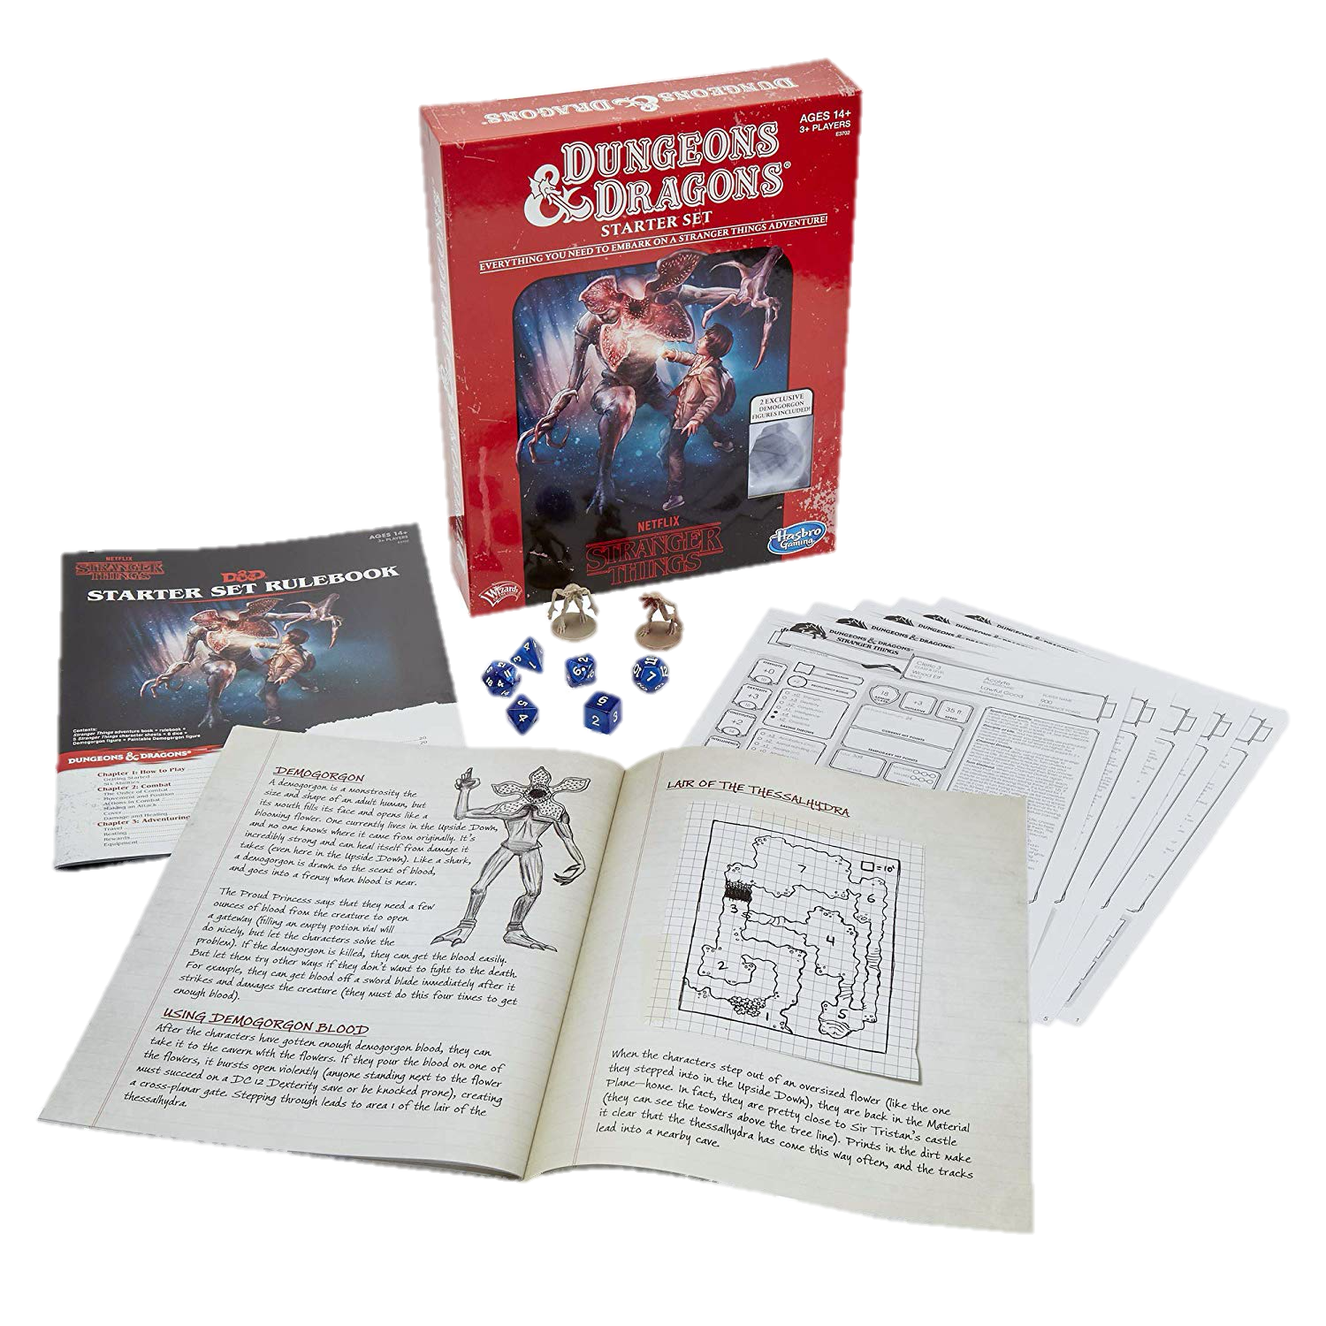
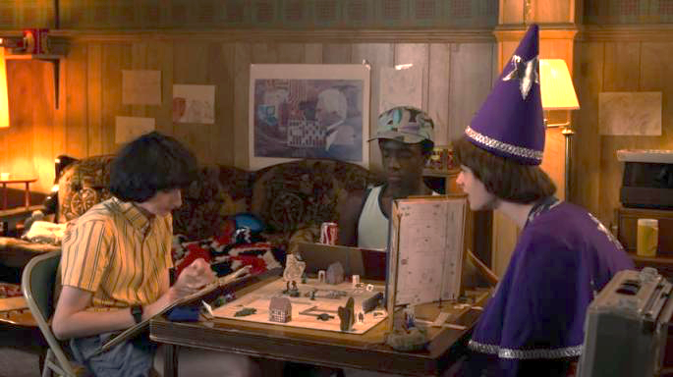
Paper & Pencil Interactive Fiction
Dungeons & Dragons is a fantasy tabletop role playing game first published in 1974.
Notes:
One forebearer of IF is the fantasy role-playing playing game Dungeons and Dragons, a framework for a theatrical interaction, for the exploration of simulated spaces, and for puzzle solving.

Slide 10

Dungeons and Dragons (D&D)
An open world game in which the players assume the roles of characters in a story and can have them attempt any action they want.
The game is controlled by a dungeon master, who uses tables, dice, and personal judgment to decide on the effect of a character’s efforts.
The players say what their characters do within the world of the campaign (over many play sessions).
Notes:
Dice are rolled to help determine the outcome of combat and other encounters. Over the course of many adventures, the members of a party advance in level and become more powerful-and the dungeon master devises new challenges for them.
Dice, are frequently used in a typical game. The twenty-sided die and other dice of unusual shape have become iconic. Dice are used to introduce unpredictability; based on the roll of a die, events may transpire that were not anticipated, foiling even the dungeon master’s plans.

Slide 11
Old-School Interactive Fiction
Limited Action Space
Full Action Space
Tabletop Roleplaying Games
Choose-Your-Own Adventures
Notes:
Branching narrative vs completely improvised

Slide 12
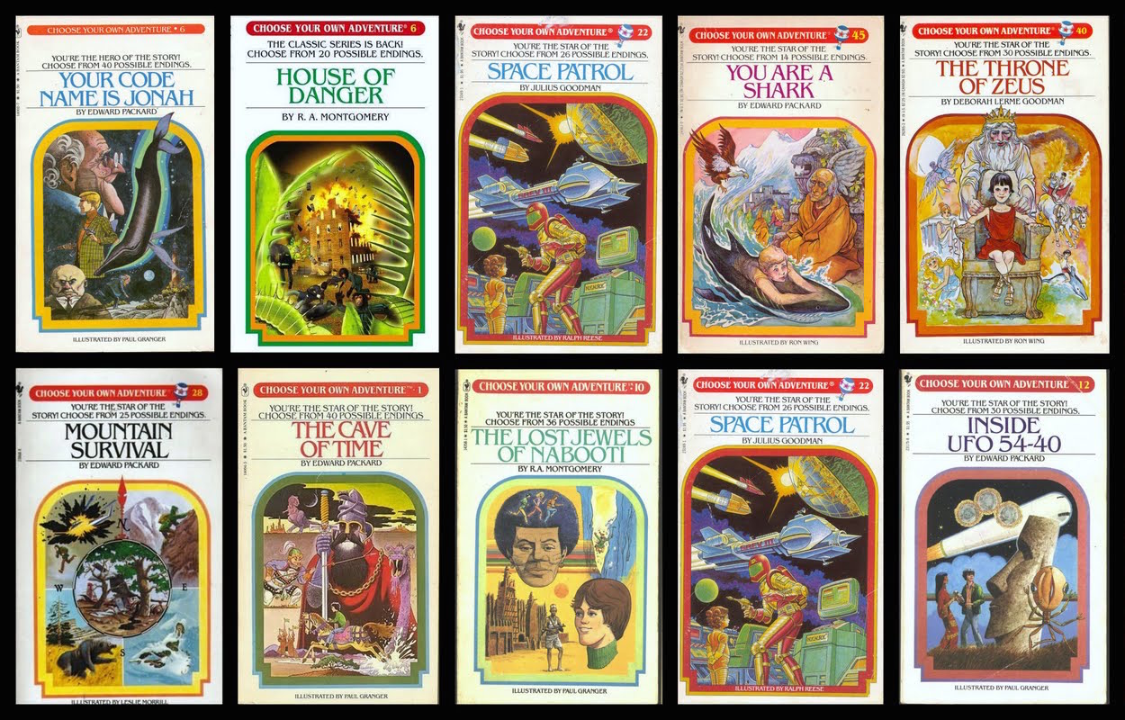
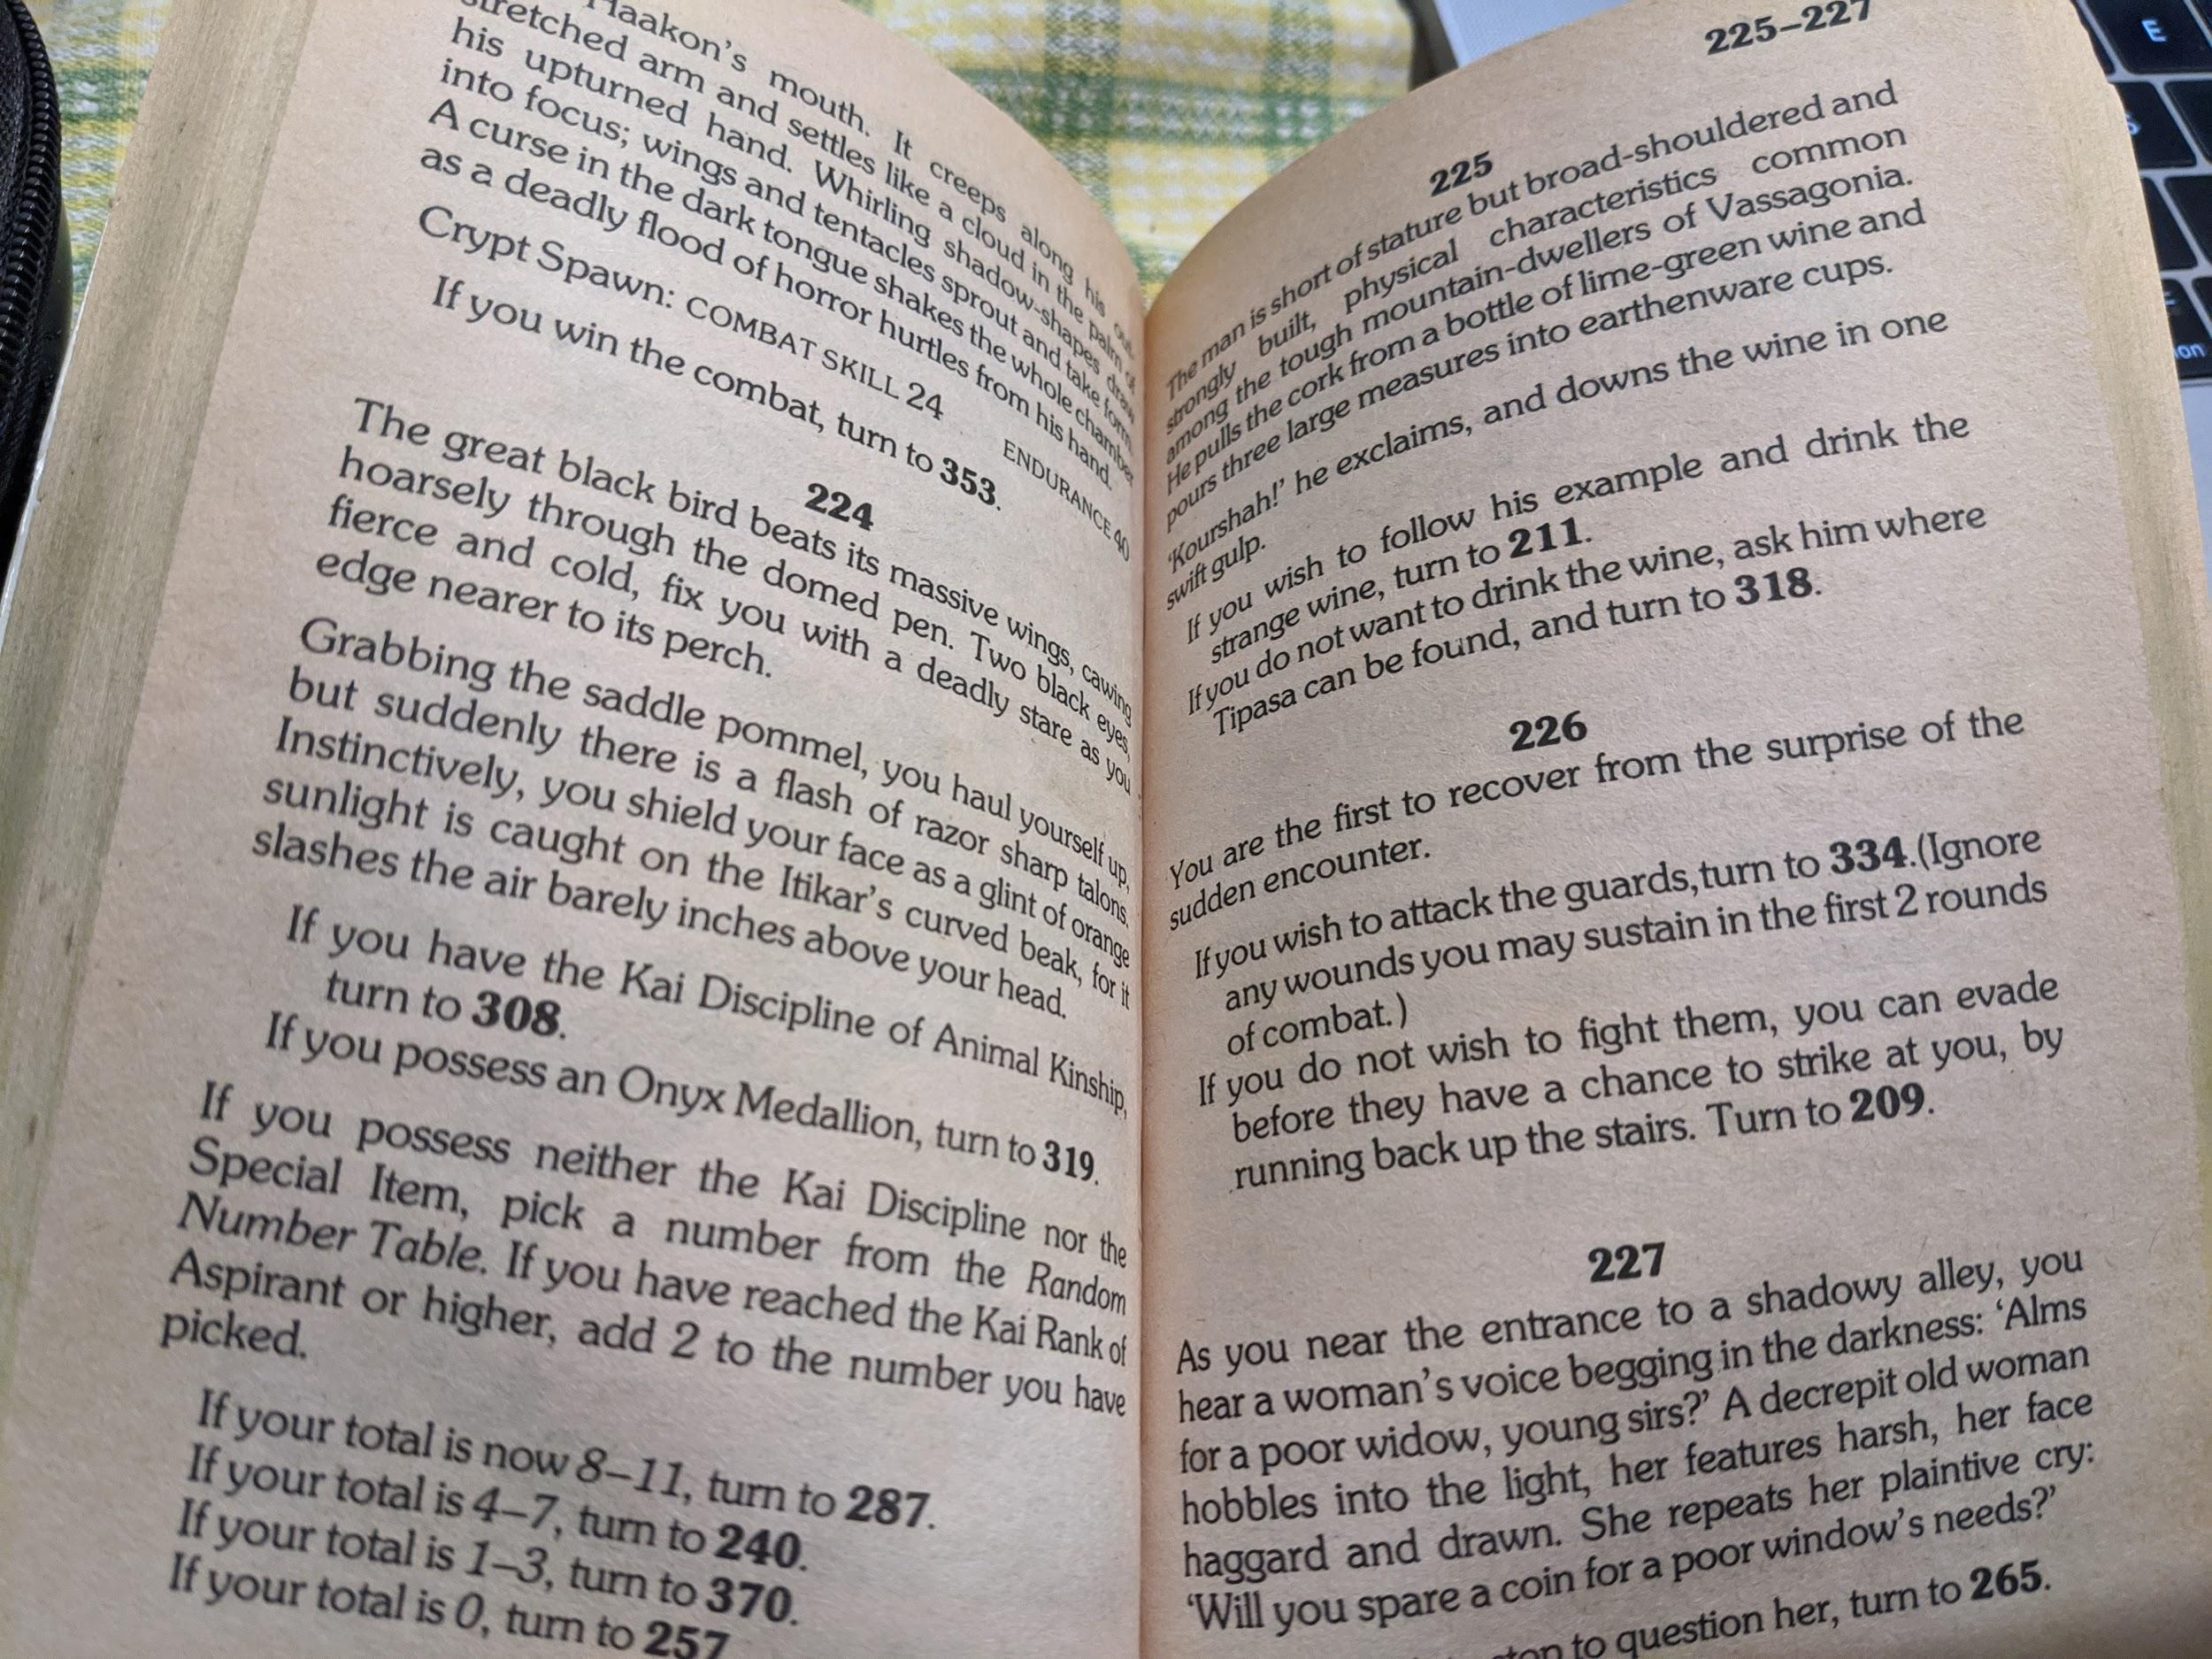
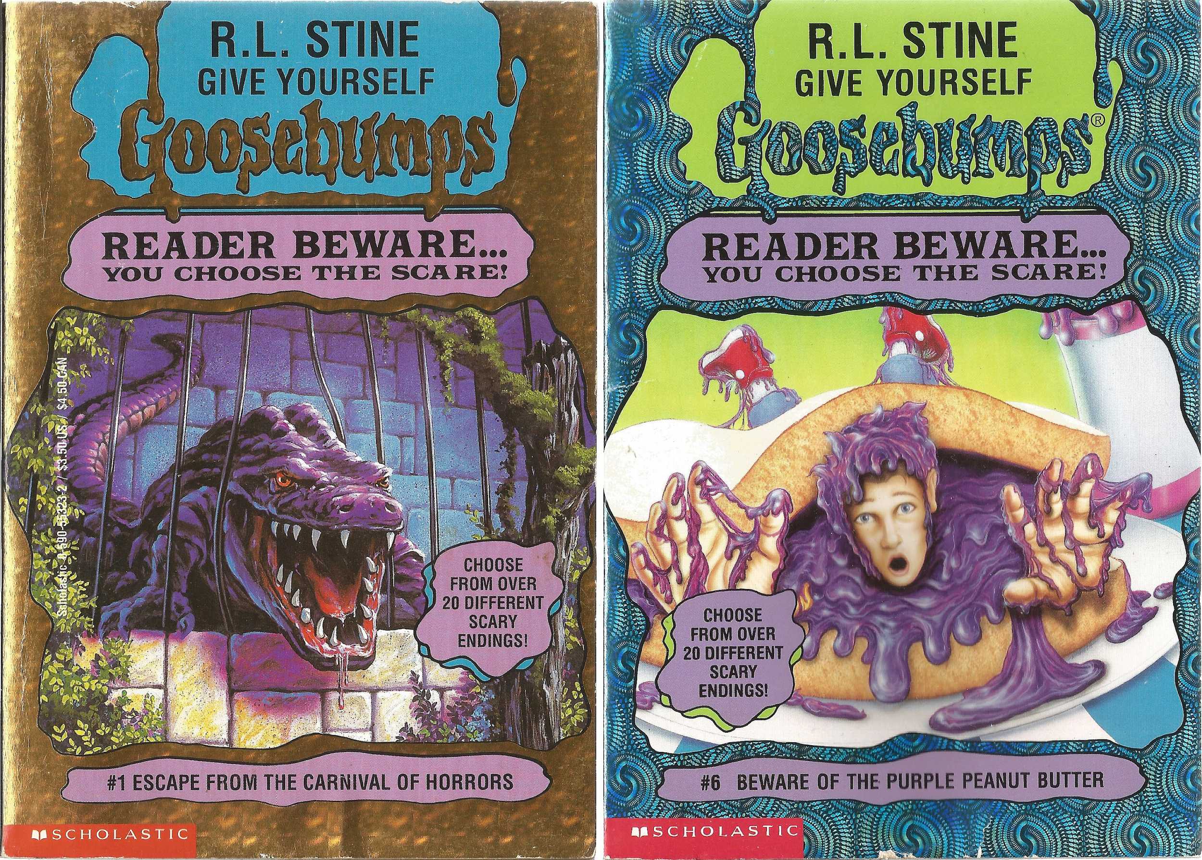
Paper Interactive Fiction
In the late 1970s, “Choose your own adventure” books grew in popularity.
Notes:
If you possess the Onyx Medallion, turn to 319.

Slide 13
Paper Interactive Fiction
In the late 1970s, “Choose your own adventure” books grew in popularity.
TODO: screenshot
Notes:
If you possess the Onyx Medallion, turn to 319.
If you wish to fight them, page 334, otherwise page 209.

Slide 14
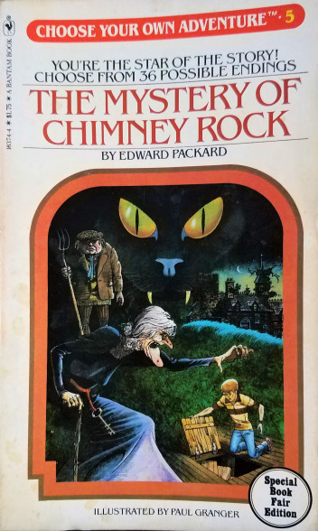
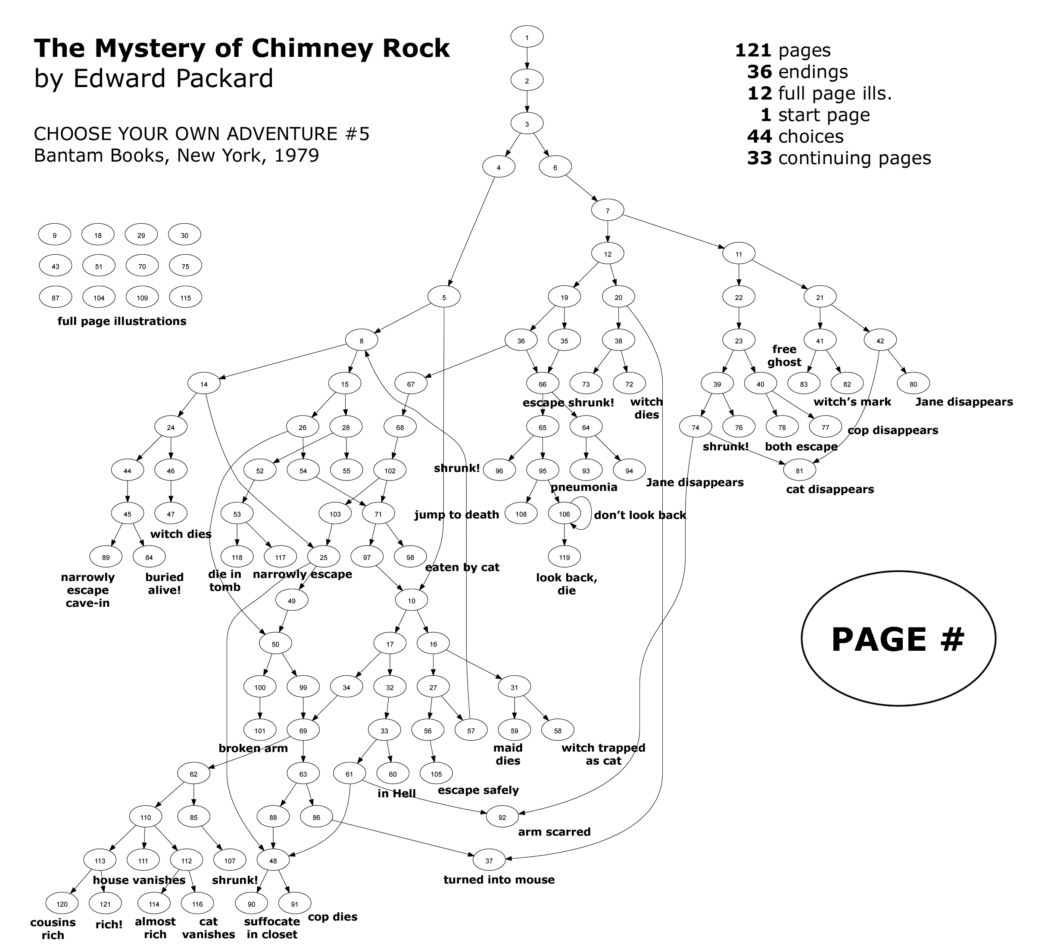
https://www.seanmichaelragan.com/html/[2008-03-07]_Choose_Your_Own_Adventure_book_as_directed_graph.shtml

Slide 15
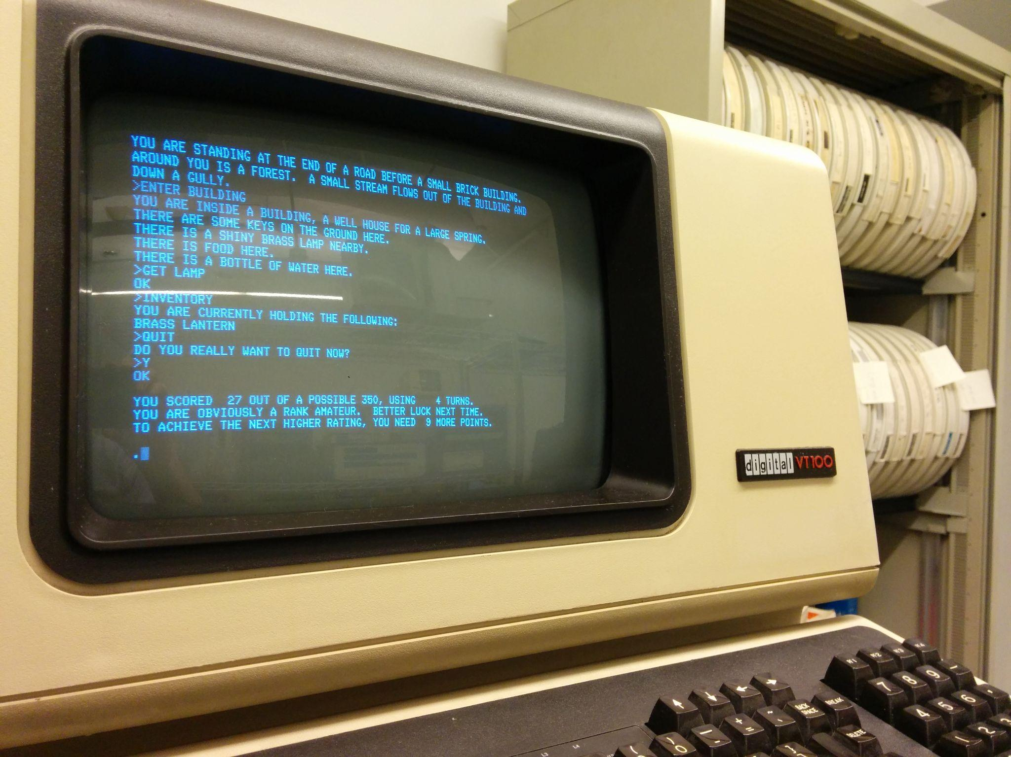

The Birth of Interactive Fiction Computer Games
Colossal Cave Adventure
Made in 1975 by Will Crowther
https://en.wikipedia.org/wiki/Colossal_Cave_Adventure#/media/File:Will_Crowther_Fall_2012.jpg
https://upload.wikimedia.org/wikipedia/commons/d/d8/Colossal_Cave_Adventure_on_VT100_terminal.jpg

Slide 16
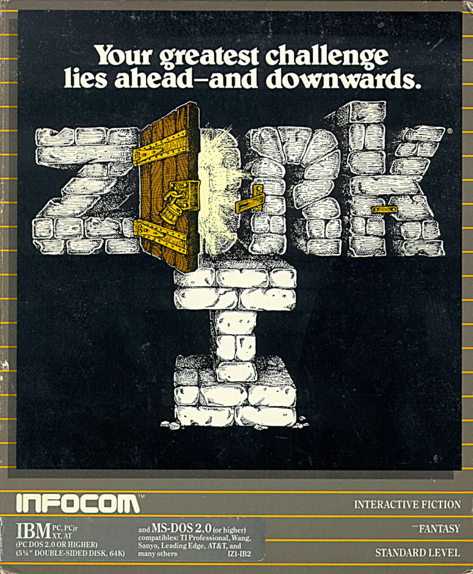
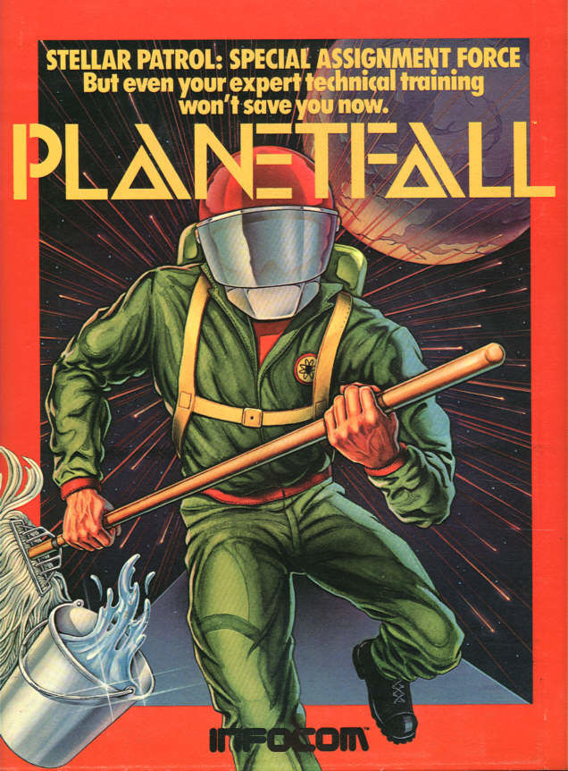
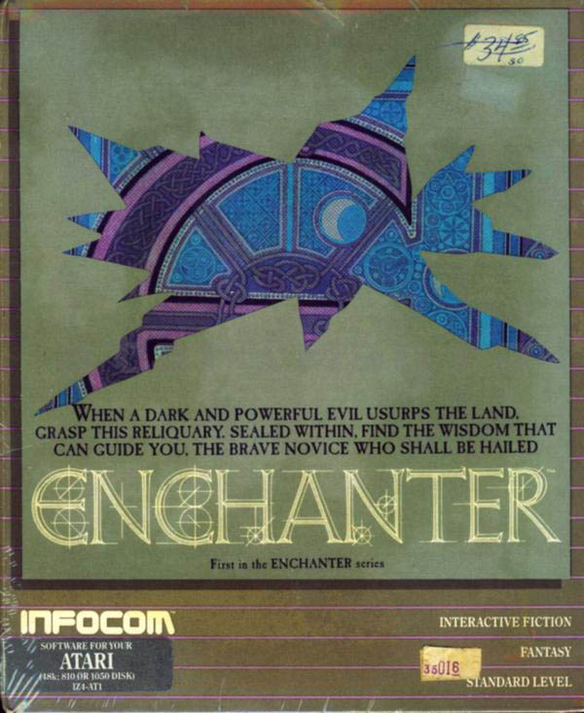
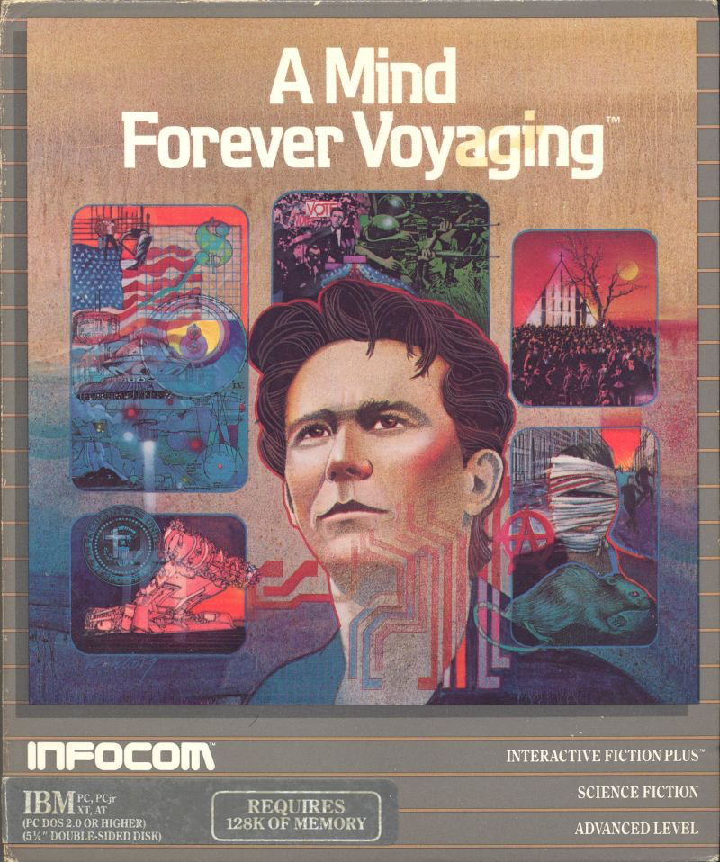
It became a thing
Interactive Fiction/Text Adventure Games were the best-selling computer games of the 1980s. A company called Infocom created the most popular titles.
1979
1983
1983
1985

Slide 17
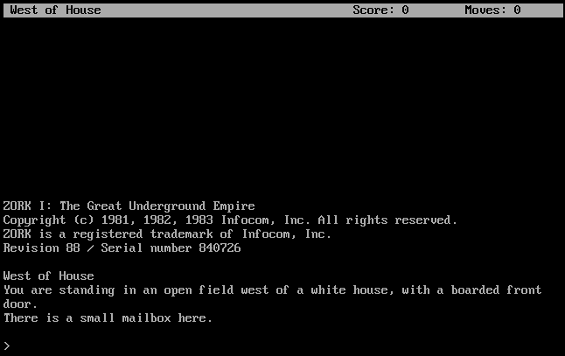
Notes:
Looked like this (from Zork I)

Slide 18
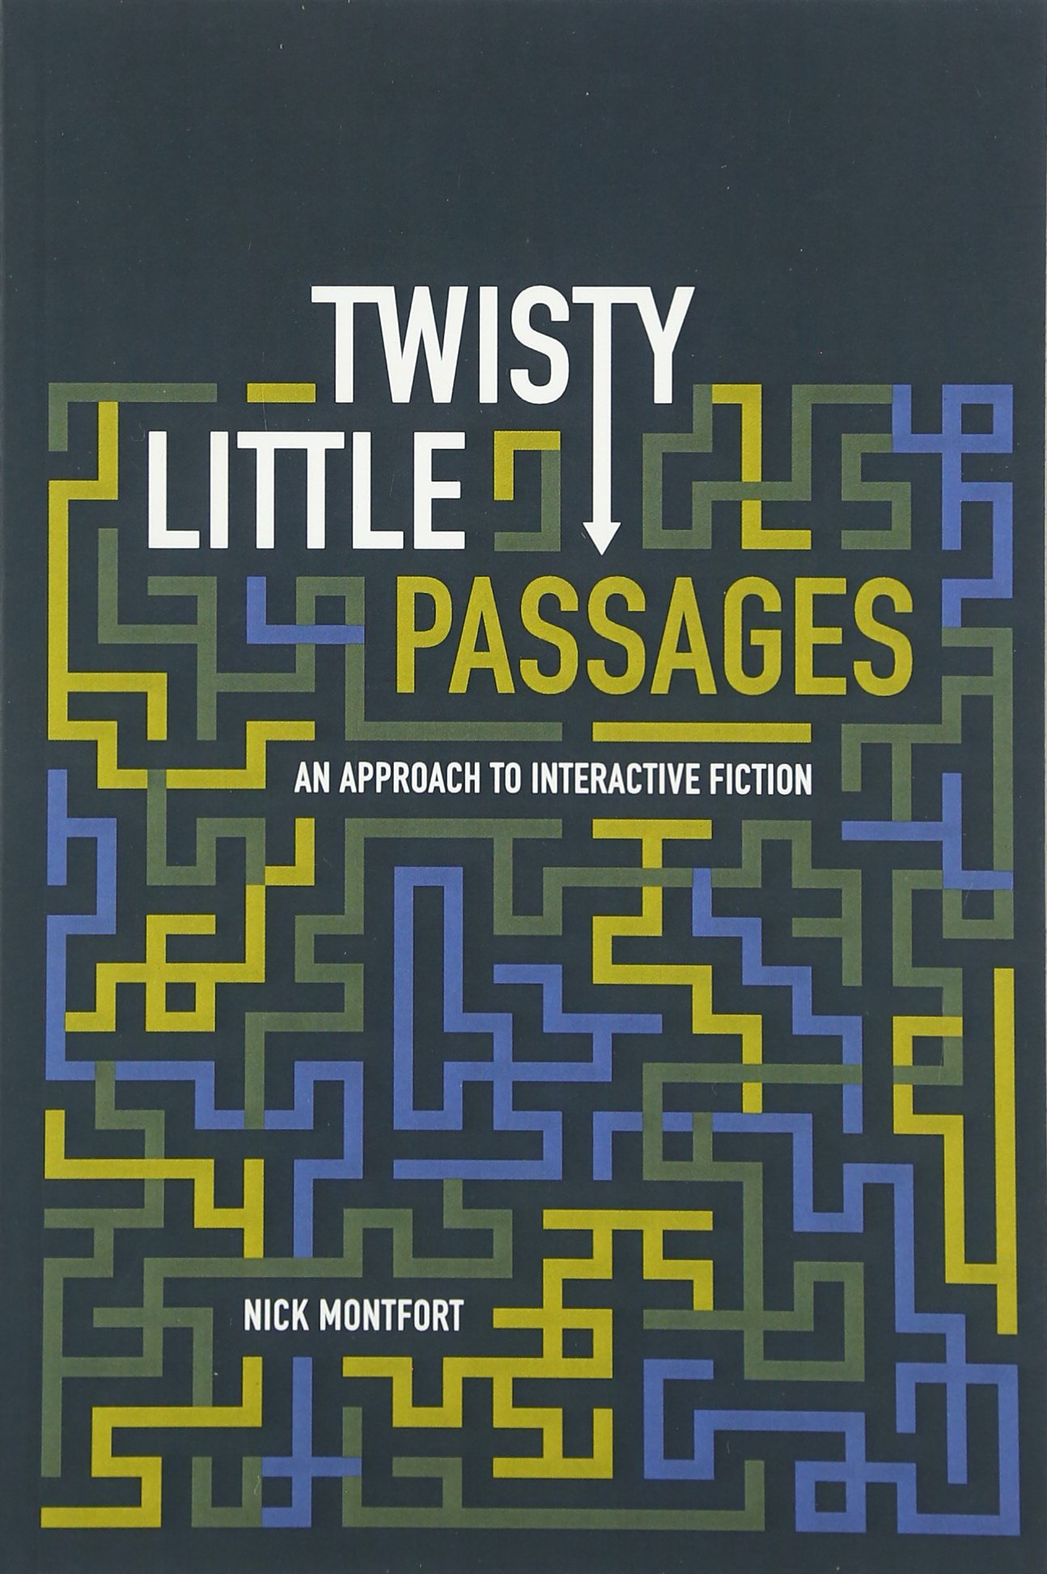
Components of Interactive Fiction Games
The parser, which is the component that analyzes natural language input in an interactive fiction work.
The world model, which is setting of an interactive fiction work.
Notes:
The simulated world is represented computationally in some sort of data structure or collection of objects. It is this simulated world that distinguishes a work of interactive fiction from a conversational character or from an expert system that employs natural language understanding.

Slide 19
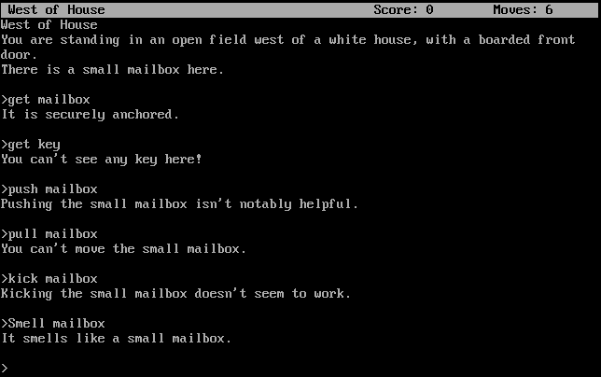

The Parser
Notes:
Regular expression

Slide 20
Commands
Players input simple sentences such as “get key” or “go east”, which are interpreted by a text parser. Parsers may vary in sophistication; the first text adventure parsers could only handle two-word sentences in the form of verb-noun pairs.
Notes:
In the case of Adventure’s “two-word” parser, which only accepts input of the form “verb” or “verb noun,” determining the grammatical structure of the input is trivial.

Slide 21
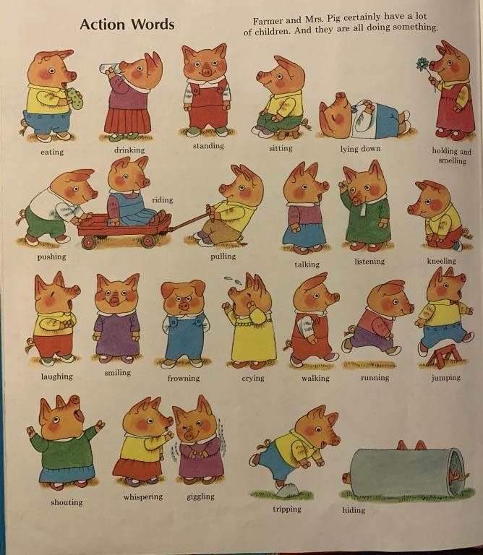
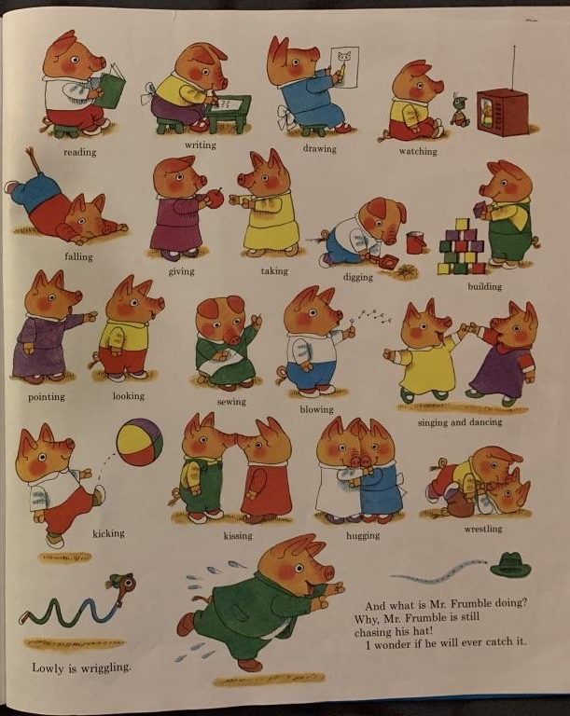
Notes:
Verbs

Slide 22
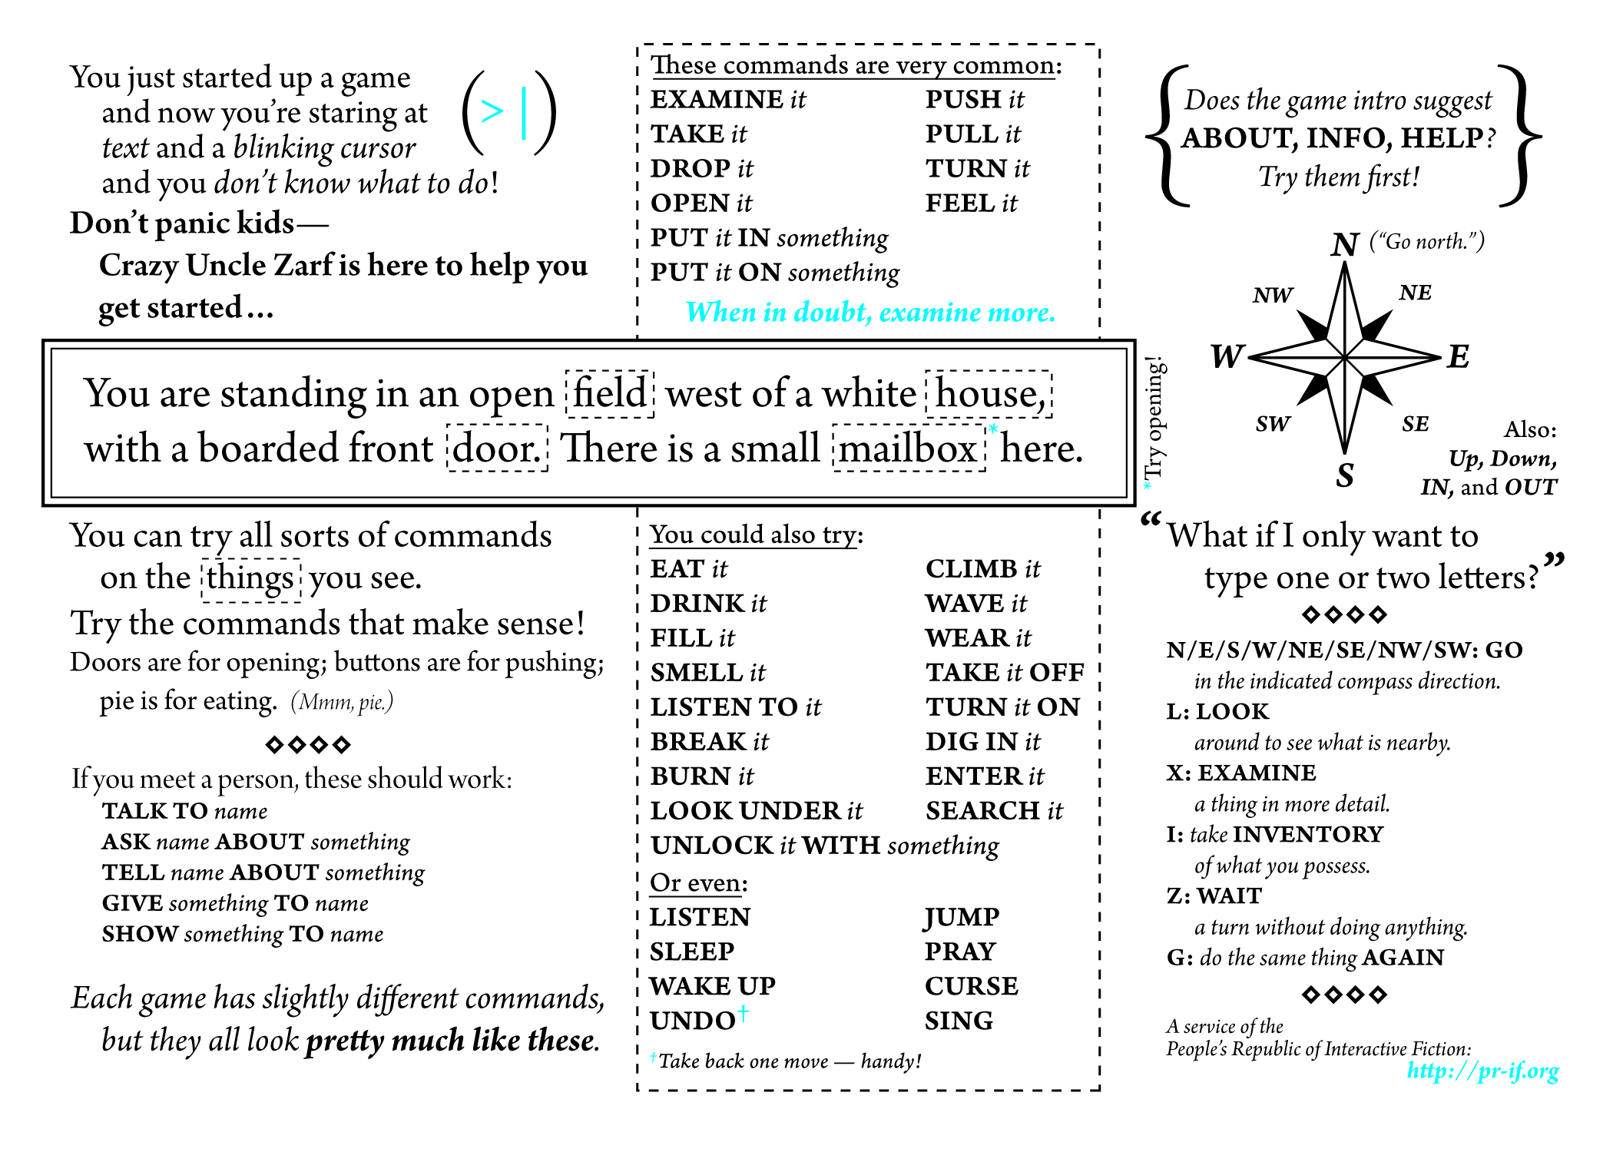

Slide 23
Vocabulary
The original Zork I (1980) had a 600-word vocabulary.
Trinity (1986) could understand stand 2,120 different words.

Slide 24


Early Parsers
Adventure’s verb-noun parser was extremely primitive but removed ambiguity.
Ambiguity means that there are multiple interpretations of a sentence, which denote distinct meanings.
Notes:
It only accepted verb-noun commands, so that limits the possible interpretations of sentences.
Adventure, with its primitive but effective way of understanding language, that endures and that became widespread. It also became the archetype of the text adventure and of interactive active fiction.

Slide 25
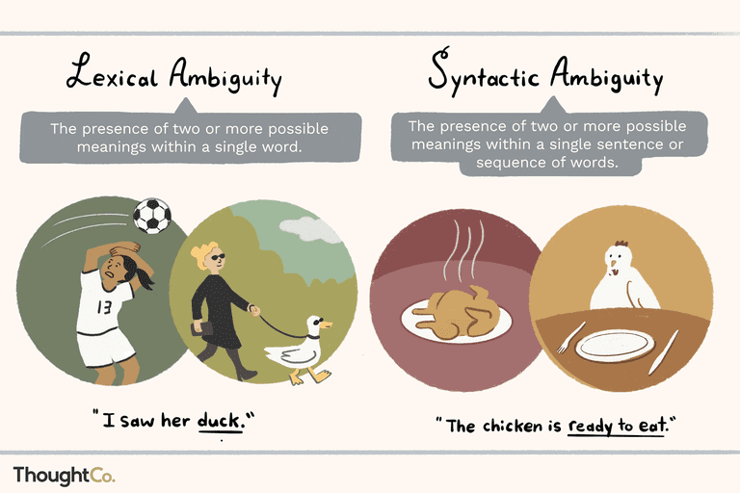

Slide 26
Basic Linguistics
Stop words: Function words like “the” could be stripped from user input, so that “GET THE LAMP” was sent to the parser as “GET LAMP”.
Prepositions: “LOOK AT” and “LOOK UNDER” were only considered different by the parser if they were implemented as separate verbs and mapped onto different actions.
Direct and indirect objects: Some parsers recognized direct and indirect objects like GIVE [THE BOOK] TO [CHRIS].
Notes:
Adventure has the player's character explore a mysterious cave that is rumored to be filled with treasure and gold. To explore the cave, the player types in one- or two-word commands to move their character through the cave, interact with objects in the cave, pick up items to put into their inventory, and other actions. The program acts as a narrator, describing to the player what each location in the cave has, the results of certain actions, or if it did not understand the player's commands, asking for the player to retype their actions.

Slide 27
“open the red box with the green key then go north”.
Later parsers, such as those built on ZIL (Zork Implementation Language), could understand complete sentences. They could handle more complex inputs.

Slide 28
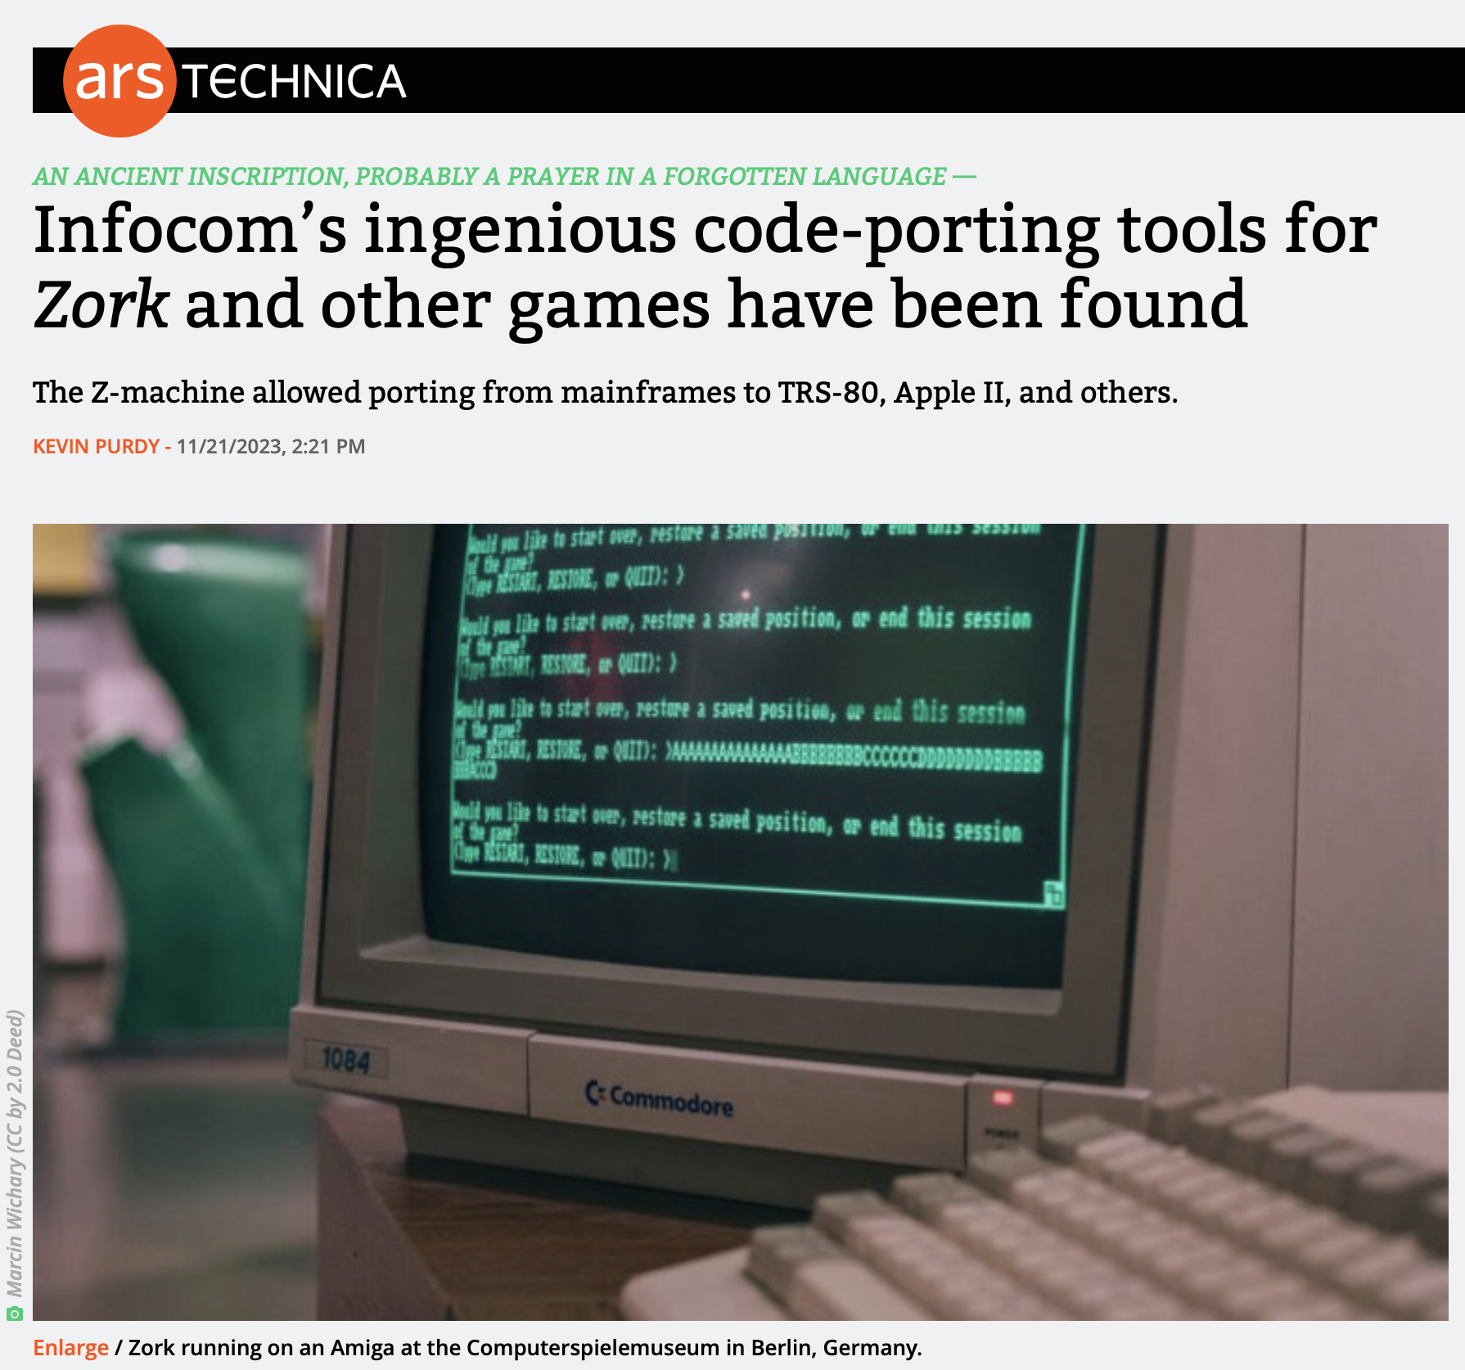

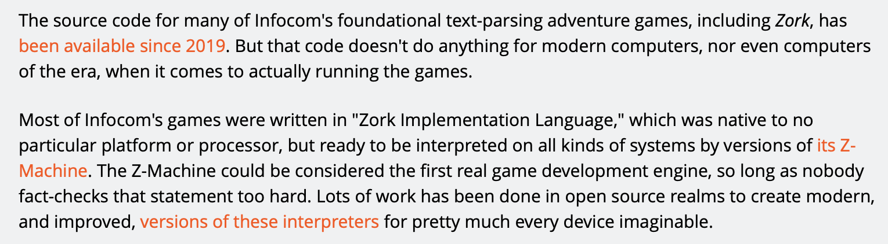
Z-machine
Infocom developed a virtual machine to deploy standardized “story files” on many platforms.
The Infocom parser was the best of its era.
It accepted complex, complete sentence commands when its competitors’ parsers were restricted to simple two-word verb-noun combinations.
Its parser was actively upgraded, and later games would ‘understand’ multiple sentence input: ‘pick up the gem and put it in my bag. take the newspaper clipping out of my bag then burn it with the book of matches’.
Notes:
Infocom developed a custom virtual machine that could be implemented on a large number of platforms, and took standardized “story files” as input. Infocom was responsible for developing the interactive style that would be emulated by many later interpreters. The Infocom parser was widely regarded as the best of its era. It accepted complex, complete sentence commands like “put the blue book on the writing desk” at a time when most of its competitors parsers were restricted to simple two-word verb-noun combinations such as “put book”. The parser was actively upgraded with new features like undo and error correction, and later games would ‘understand’ multiple sentence input: ‘pick up the gem and put it in my bag. take the newspaper clipping out of my bag then burn it with the book of matches’.

Slide 29




Why were parsers so bad?
Limited computational resources. Computers had ≤128 KB of memory
Language is difficult. There are many things that make human languages genuinely challenging for a computer to process.
Keyword-based commands. Only exact matches worked properly. No synonyms, no paraphrases.
Everything was manual. Game developers had to anticipate all possible commands, and manually code the responses.
No machine learning. This was prior to the advent of machine-learning-based natural language processing

Slide 30
Components of Interactive Fiction Games
The parser, which is the component that analyzes natural language input in an interactive fiction work.
The world model, which is setting of an interactive fiction work.
Notes:
The simulated world is represented computationally in some sort of data structure or collection of objects. It is this simulated world that distinguishes a work of interactive fiction from a conversational character or from an expert system that employs natural language understanding.

Slide 31

World Model
It represents the physical environment, and things like • Settings or locations • Physical objects in each setting • The player’s character • Non-player characters It also represents and simulates the physical laws of the environment.
Notes:
The world model is typically implemented in the interactive fiction program as some type of graph or tree with associated procedures.

Slide 32
Locations
You are at a complex junction. A low hands and knees passage from the north joins a higher crawl from the east to make a walking passage going west. There is also a large room above. The air is damp here.
A location in Colossal Cave Adventure
Notes:
https://en.wikipedia.org/wiki/Colossal_Cave_Adventure

Slide 33

Navigation in a Text-based World
Cardinal Directions: Go North/South/East/West/
Northwest/Northeast/Southwest/Southeast
Also: Go Up, Down, In and Out
One letter commands were also supported: N/E/S/W/NE/SE/NW/SW
Look/L: look around to see what is nearby
Not every direction is possible in every location.

Slide 34
Colossal Cave Adventure
You are standing at the end of a road before a small brick building. Around you is a forest. A small stream flows out of the building and down a gully.
> go south
You are in a valley in the forest beside a stream tumbling along a rocky bed.
Notes:
Adventure has the player's character explore a mysterious cave that is rumored to be filled with treasure and gold. To explore the cave, the player types in one- or two-word commands to move their character through the cave, interact with objects in the cave, pick up items to put into their inventory, and other actions. The program acts as a narrator, describing to the player what each location in the cave has, the results of certain actions, or if it did not understand the player's commands, asking for the player to retype their actions.

Slide 35
As a Data Structure
You can implement an IF game as a directed graph.
Each location in a node in the graph.
Edges are connections to adjacent locations.
Edges are labeled with the direction.
Possible commands at a location are
the labels of the outward edges.
Locations can hold Objects.

Slide 36
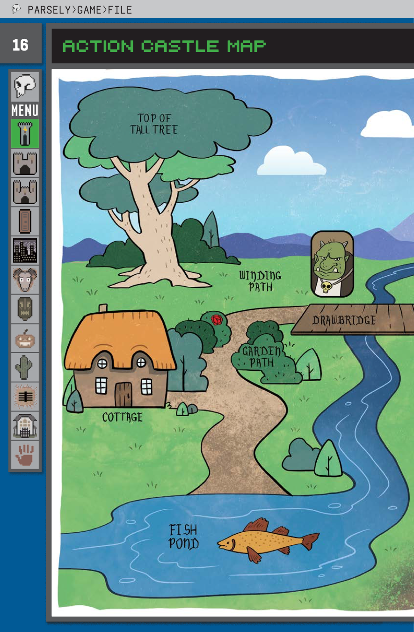
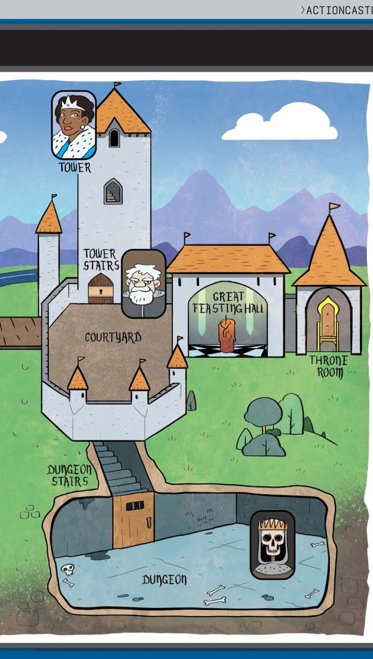

Notes:
This is the Action Castle map from Jared A Sorensen’s Parsley book.

Slide 37
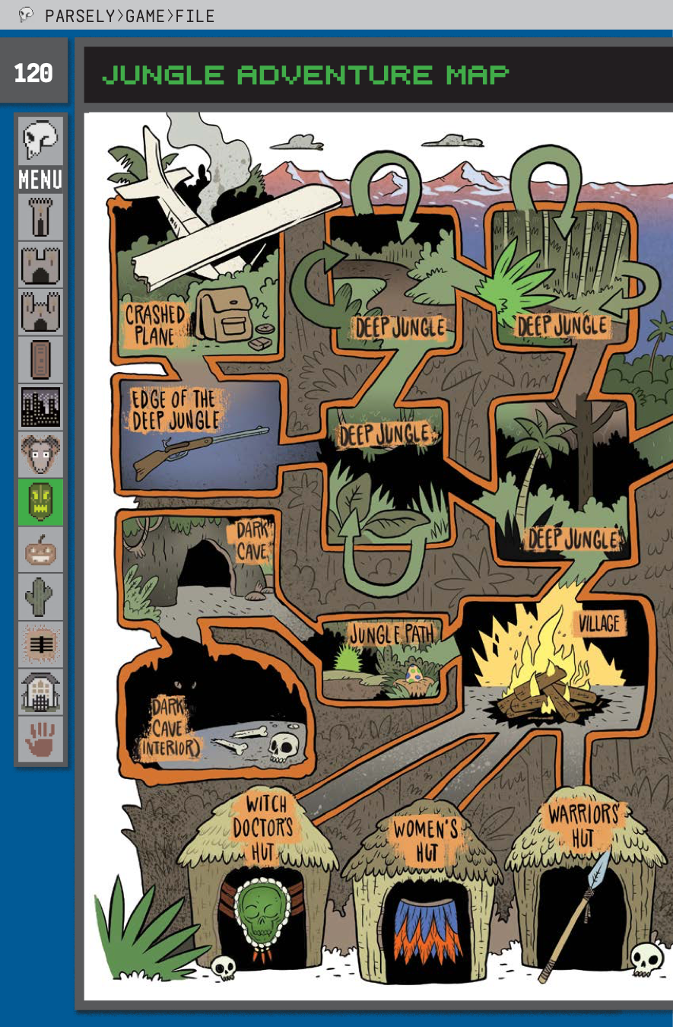
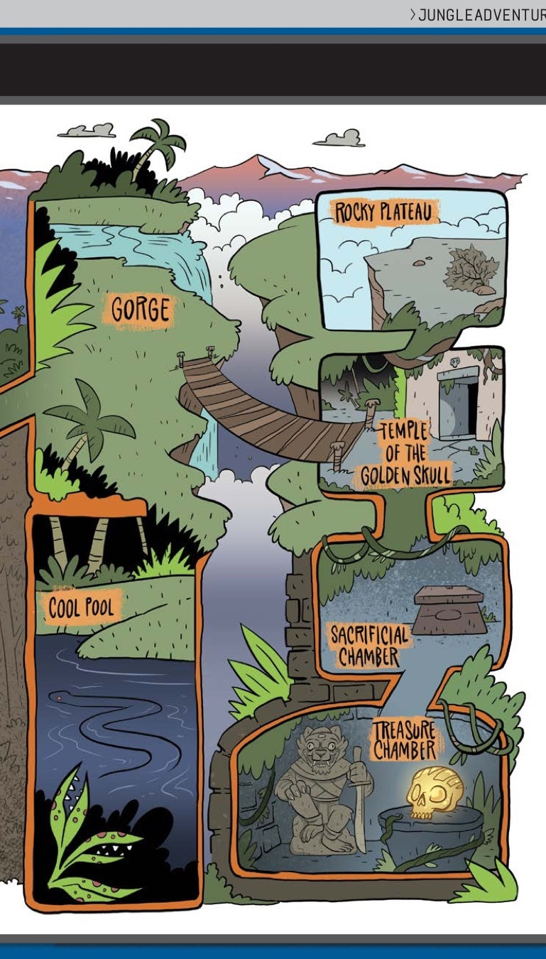
DEEP JUNGLE
You are lost in the deep jungle.
> Each location within the Deep Jungle has four exits: NORTH, SOUTH, EAST and WEST. Some of these—marked with U-turn arrows—lead back to the previously entered area.
> If the player examines the compass while lost in the Deep Jungle, the actual exits are revealed and the U-turns are ignored.
Notes:
This is the Jungle Adventure Map from Jared A Sorensen’s Parsley book.

Slide 38
Maps and Mazes
There was a maze in Adventure that was essentially impossible to get through without making a map. The pirate’s maze offered rooms that were all uniformly described as “a maze of twisty little passages, all alike.”
To figure out which room was which, the player character had to drop objects to mark the different rooms. The rooms, once all alike, could then be differentiated based on their contents, and mapping ping of the usual sort was possible.

Slide 39
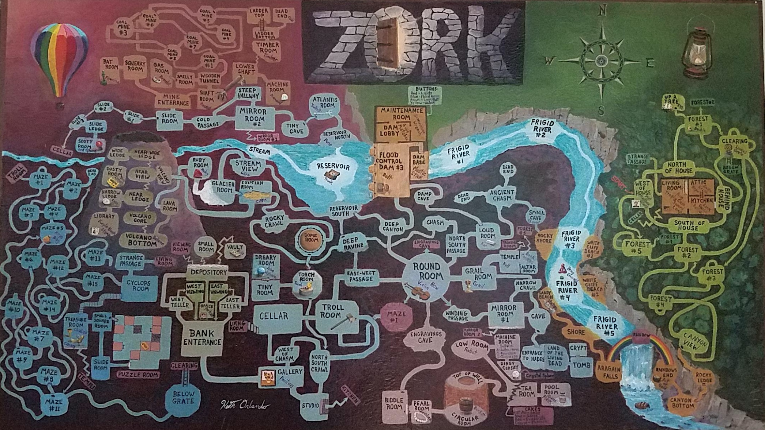
Notes:
Credit: Reddit user ion_bond Source URL: https://www.reddit.com/r/zork/comments/5ximil/zork_map_mit_version_fantastic_game_i_spent_some/

Slide 40
Objects
In Adventure, instead of a realistic simulation of caving, the author placed five treasures within as an incentive to explore the cave.
The player had to figure out how to get past a snake to move deeper into the cave. The player is attacked by dwarves and their treasure is stolen by a pirate.

Slide 41
Examine Lamp
Items represent things in the game world. Usually, they are mentioned in the description of a location like:
You are on the dungeon stairs. From above, you can make out some of the king’s guards talking about current events. Someone’s left an old lamp here.
Players can inspect them with the “EXAMINE” command.
> EXAMINE LAMP This old lamp seems like it’s seen some use. It ran out of oil ages ago.

Slide 42
Get Lamp
Players can pick up objects in the world, and they are added to the player’s inventory with the “GET” command. The inventory is the set of things that the player has collected along the way.
Oftentimes, they are used to solve puzzles. For instance, you must have a lamp in your inventory in order to explore a dark cave. To list all items that you have, you can issue the “INVENTORY” command (or just the letter “I”).

Slide 43
Light lamp
Objects often have special commands associated with them. For instance, to solve the darkness puzzle you must say “LIGHT LAMP”.
Some special commands require more than one object in your inventory.

Slide 46
Object properties
Containment: Objects may have contents (the bottle can have wine in it)
Weight: Objects have weight (some objects might be too heavy to lift)
Position: An object may be in, on, or under another object

Slide 47
People are objects too
In Zork, a handful of living opponents thwart the adventurer: the troll, who stays put in a single room and serves as an obstacle; the vampire bat, who can carry off the adventurer; the cyclops, who can dine on the adventurer; and the thief, who wanders around the underground areas stealing items from the adventurer.
These people/opponents can be implemented as objects too. People objects often have a special command for dialogue via “TALK TO”.

Slide 48
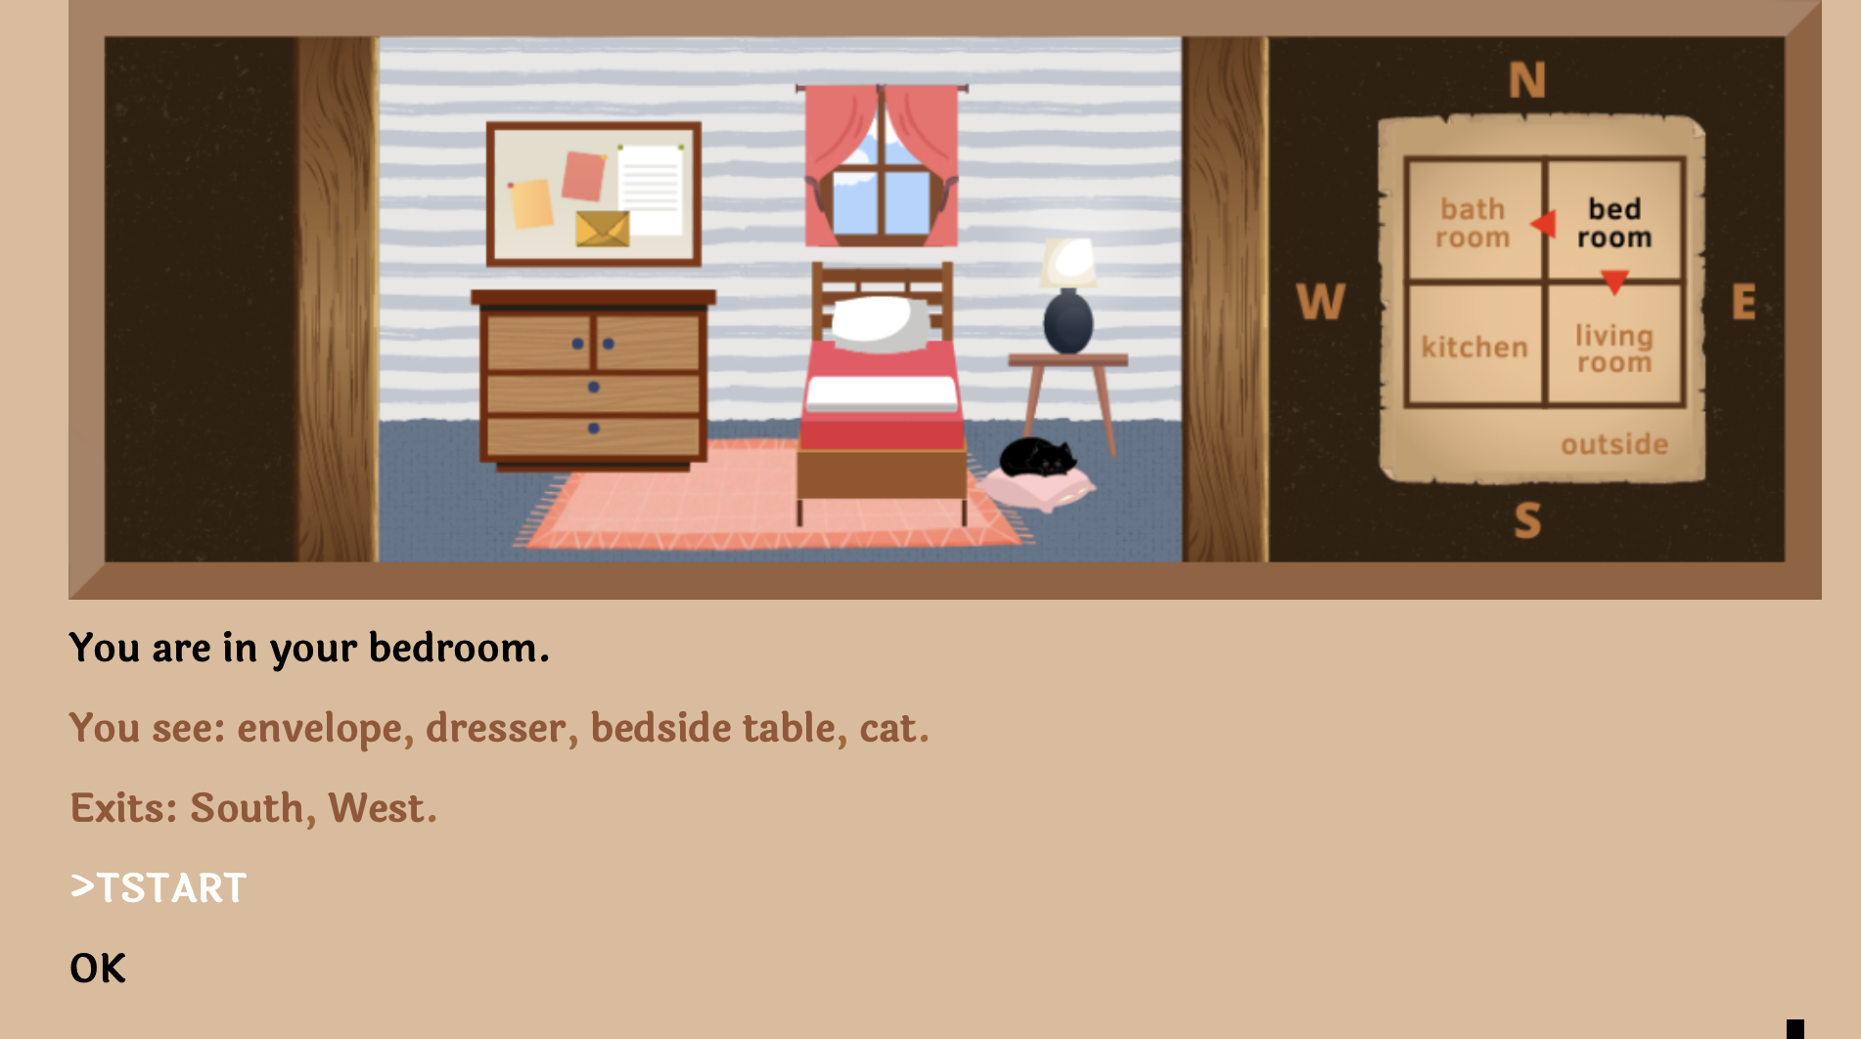

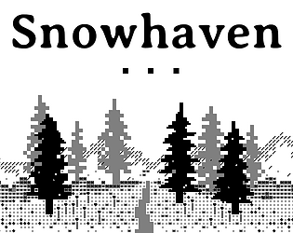
In-class Activity: Play a Game
And answer these question:
What commands did you try that didn’t work?
How does this experience differ from reading a non-interactive story?
https://grizel.itch.io/
Record your game by typing “TSTART” at the beginning.
Type “TSTOP” to download your game.
Notes:
Can they

Slide 49
Puzzles
In most interactive fiction, puzzles (sorts of challenges or obstacles) are part of the world the player character moves through. In order to complete the IF work, the interactor must figure out how to meet these challenges.

Slide 50
Puzzle Solutions
The solutions may be arrived at through the player character’s senses or by having the player character manipulate things in the surroundings and then observe the results to determine the workings of the world.
Most interactive fiction does not have great replay value. You cannot simply “replay” a riddle if you know its answer.
However, once you learn to play a board game, the knowledge gained from playing it once game doesn’t ruin the experience of playing it again.

Slide 51
Zork’s diamond machine
In the coal mine, the player character finds a machine with a tiny slot in the top of it. What this machine does, and how to turn it on, is unclear.
The solution is to put some coal into the machine, and then turn on the machine using the screwdriver. This results in the coal being compressed with great force producing a diamond.
The player can act as scientist and put anything inside, then observe the results.

Slide 52
Guess the Verb
A few puzzles require the player “guess the verb” and perform an action that would not be obvious from the commands available. The game's parser does not understand unless the player uses a particular way to phrase the command (sometimes non-obvious).
For example, if there is a crate to be opened with a crowbar and the only way to open it is to "pry crate with crowbar", other actions like "open crate with crowbar" give a misleading response. Usually this is a deficiency in the parser. Some games like Ad Verbum by Nick Montfort intentionally include guess-the-verb puzzles to good effect in contexts where the puzzles are explicitly about language.

Slide 53
Writing Style
Interactive fiction features two distinct modes of writing: the player input and the game output.
Player input is expected to be in simple command form (in linguistics, these are called imperative sentences).
> look in tea chest

Slide 54
“That was the first place you tried, hours and hours ago now, and there’s nothing there but that boring old book. You pick it up anyway, bored as you are.” –Graham Nelson Curses (1993)
Second-Person - The responses from the game are usually written using second-person pronouns like “you.” They also tend to be in present tense.
Notes:
This is because, unlike in most works of fiction, the main character is closely associated with the player, and the events are seen to be happening as the player plays.
Some IF works dispense with second-person narrative entirely, opting for a first-person perspective (‘I’) or even placing the player in the position of an observer, rather than a direct participant.
Second-Person – The reader is character within the story. This is done with the use of second-person pronouns like you. Stories and novels in second person are comparatively uncommon.

Slide 55
"I could not unlove him now, merely because I found that he had ceased to notice me." – Charlotte Brontë's Jane Eyre (1847)
First-person – A first-person narrative is a mode of storytelling in which a narrator relays events from their own point of view using the first-person pronouns "I" or "we”. The narrator is the protagonist, or retelling events that they witnessed.
Notes:
In Jane Eyre the title character is telling her own story.
Other examples of first person narration: fictional autobiographies, detective fiction, internal monologues,
https://en.wikipedia.org/wiki/First-person_narrative This device allows the audience to see the narrator's mind's eye view of the fictional universe, but it is limited to the narrator's experiences and awareness of the true state of affairs,
With a first person narrative it is important to consider how the story is being told, i.e., is the character writing it down, telling it out loud, thinking it to themselves? And if they are writing it down, is it something meant to be read by the public, a private diary, or a story meant for one other person? The way the first person narrator is relating the story will affect the language used, the length of sentences, the tone of voice and many other things. A story presented as a secret diary could be interpreted much differently than a public statement.^{[2]}
https://en.wikipedia.org/wiki/Narration A first-person point of view reveals the story through a participant narrator. First person creates a close relationship between the narrator and reader, by referring to the viewpoint character with first person pronouns like I (or we, if the narrator is part of a larger group).^{[12]} That is, the narrator openly acknowledges their own existence. Frequently, the first-person narrator is the protagonist, whose inner thoughts are expressed to the audience, even if not to any of the other characters. A first person narrator with limited omniscience is not able to witness or understand all facets of any situation. Thus, a narrator with this perspective will not be able to report the circumstances fully and will leave the reader with a subjective record of the plot details. Additionally, this narrator's character could be pursuing a hidden agenda or may be struggling with mental or physical challenges that further hamper their ability to tell the reader the whole, accurate truth of events. This form includes temporary first-person narration as a story within a story, wherein a narrator or character observing the telling of a story by another is reproduced in full, temporarily and without interruption shifting narration to the speaker. The first-person narrator can also be the focal character.

Slide 56
"You are not the kind of guy who would be at a place like this at this time of the morning. But here you are, and you cannot say that the terrain is entirely unfamiliar, although the details are fuzzy.” Jay McInerney's Bright Lights, Big City (1984)
Second-Person – The reader is character within the story. This is done with the use of second-person pronouns like you. Stories and novels in second person are comparatively uncommon.
Notes:
In Jane Eyre the title character is telling her own story.
https://en.wikipedia.org/wiki/First-person_narrative This device allows the audience to see the narrator's mind's eye view of the fictional universe, but it is limited to the narrator's experiences and awareness of the true state of affairs
https://en.wikipedia.org/wiki/Narration A first-person point of view reveals the story through a participant narrator. First person creates a close relationship between the narrator and reader, by referring to the viewpoint character with first person pronouns like I (or we, if the narrator is part of a larger group).^{[12]} That is, the narrator openly acknowledges their own existence. Frequently, the first-person narrator is the protagonist, whose inner thoughts are expressed to the audience, even if not to any of the other characters. A first person narrator with limited omniscience is not able to witness or understand all facets of any situation. Thus, a narrator with this perspective will not be able to report the circumstances fully and will leave the reader with a subjective record of the plot details. Additionally, this narrator's character could be pursuing a hidden agenda or may be struggling with mental or physical challenges that further hamper their ability to tell the reader the whole, accurate truth of events. This form includes temporary first-person narration as a story within a story, wherein a narrator or character observing the telling of a story by another is reproduced in full, temporarily and without interruption shifting narration to the speaker. The first-person narrator can also be the focal character.

Slide 57
"There was a table and the March Hare and the Hatter were having tea at it: a Dormouse was sitting between them, and the other two were using it as a cushion..." – Alice’s Adventures in Wonderland (1865)
Third-Person – All characters are referred to with third person pronouns like he, she, or. This makes it clear that the narrator is an uninvolved entity who conveys the story but is not a character in it.
Notes:
In Jane Eyre the title character is telling her own story.
Other examples of first person narration: fictional autobiographies, detective fiction, internal monologues,
https://en.wikipedia.org/wiki/First-person_narrative This device allows the audience to see the narrator's mind's eye view of the fictional universe, but it is limited to the narrator's experiences and awareness of the true state of affairs,
With a first person narrative it is important to consider how the story is being told, i.e., is the character writing it down, telling it out loud, thinking it to themselves? And if they are writing it down, is it something meant to be read by the public, a private diary, or a story meant for one other person? The way the first person narrator is relating the story will affect the language used, the length of sentences, the tone of voice and many other things. A story presented as a secret diary could be interpreted much differently than a public statement.^{[2]}
https://en.wikipedia.org/wiki/Narration A first-person point of view reveals the story through a participant narrator. First person creates a close relationship between the narrator and reader, by referring to the viewpoint character with first person pronouns like I (or we, if the narrator is part of a larger group).^{[12]} That is, the narrator openly acknowledges their own existence. Frequently, the first-person narrator is the protagonist, whose inner thoughts are expressed to the audience, even if not to any of the other characters. A first person narrator with limited omniscience is not able to witness or understand all facets of any situation. Thus, a narrator with this perspective will not be able to report the circumstances fully and will leave the reader with a subjective record of the plot details. Additionally, this narrator's character could be pursuing a hidden agenda or may be struggling with mental or physical challenges that further hamper their ability to tell the reader the whole, accurate truth of events. This form includes temporary first-person narration as a story within a story, wherein a narrator or character observing the telling of a story by another is reproduced in full, temporarily and without interruption shifting narration to the speaker. The first-person narrator can also be the focal character.

Slide 58
IF Summary
What’s the difference between TTRPGs like D&D and Choose-Your-Own-Adventure games?
Why were IF commands so simple?
What makes IF games hard to win?

Slide 59
Stories
What kind of stories are possible in interactive fiction? Can they be high-brow literature?

Slide 60
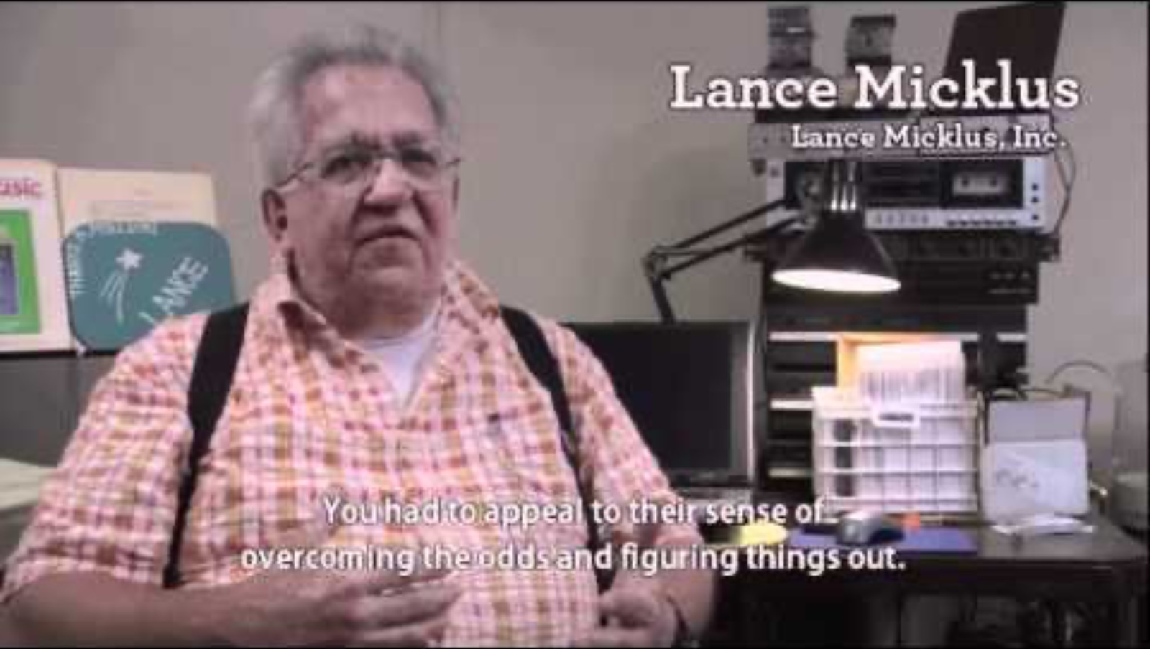
Notes:
https://www.youtube.com/watch?v=LRhbcDzbGSU&t=3955
Narratives (The quest – 1 minute)
105:55 - Robert Pinsky
107:06 - potential end - The imagery was very traditional

Slide 61
Automated Story Generation

Slide 62
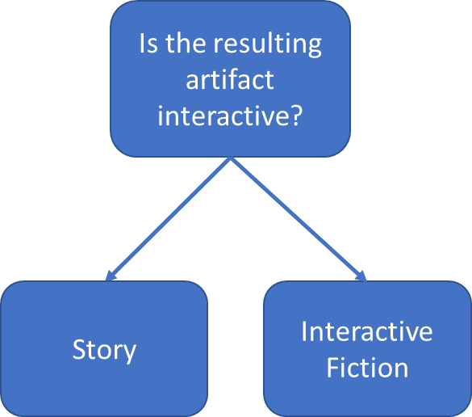
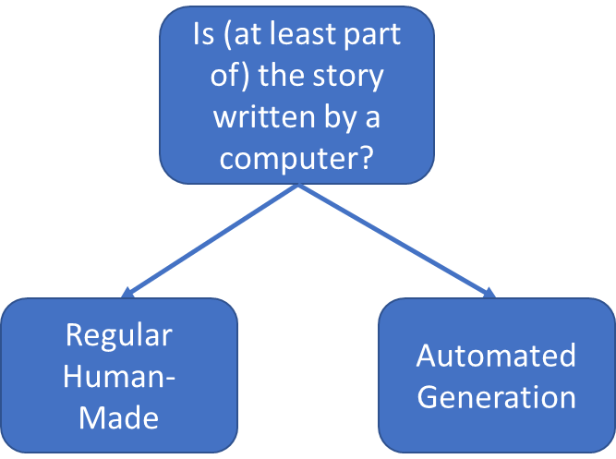
Interactive Fiction vs Automated Story Generation
What is it?
How was it made?

Slide 63
Early Systems
TALE-SPIN (1977):
One day,
JOE WAS THIRSTY.
JOE WANTED NOT TO BE THIRSTY.
JOE WANTED TO BE NEAR THE WATER.
UNIVERSE (1984):
>> LIZ tells NEIL she doesn’t love him
working on goal – (WORRY-ABOUT NEIL) – using plan BE-CONCERNED
Possible candidates – MARLENA JULIE DOUG ROMAN DON CHRIS KAYLA
Using Marlena for WORRIER
>> MARLENA is worried about NEIL
Notes:
TALE-SPIN, developed by James Meehan in 1977, is a pioneering program in the field of artificial intelligence and natural language processing, particularly in the area of automatic story generation. It represents a significant milestone in the history of interactive fiction and text generation. Here are some key aspects that current students should know about TALE-SPIN:
1. **Concept and Design**: TALE-SPIN was designed to generate stories by simulating the motivations, emotions, and actions of its characters. The program created characters with specific goals and the ability to plan how to achieve these goals. This approach was a significant departure from earlier story generation systems that often relied on predefined plots or random combinations of story elements.
2. **Character-Driven Narratives**: One of the novel features of TALE-SPIN was its focus on character-driven narratives. Characters in TALE-SPIN were given psychological needs (like hunger), interpersonal relationships, and specific personality traits. These elements influenced their decisions and interactions, leading to more dynamic and unpredictable stories.
3. **Internal Simulation and Planning**: TALE-SPIN used internal simulation and planning algorithms to create its stories. It simulated a world in which characters would plan and execute actions based on their goals and the current state of the world. This approach is an early example of procedural content generation, a technique widely used in modern game design and interactive fiction.
4. **Narrative Structure**: The stories generated by TALE-SPIN had a basic narrative structure, including a beginning, a series of events, and a resolution. The program generated these stories by considering the logical sequence of events and the motivations of the characters.
5. **Limitations and Critique**: While innovative, TALE-SPIN had limitations. Some of its generated stories were nonsensical or lacked coherence, highlighting the challenges of creating a fully automated story generation system. It also struggled with the complexity and unpredictability of narrative storytelling.
6. **Legacy and Influence**: TALE-SPIN's approach to story generation has influenced subsequent developments in interactive fiction and AI-driven storytelling. It represents an early attempt to create narratives based on character psychology and world simulation, concepts that are central to many modern interactive fiction tools and game engines.
7. **Educational Value**: For students, TALE-SPIN serves as a historical example of the challenges and possibilities in automated story generation. It demonstrates the importance of character development, world modeling, and narrative coherence in creating engaging stories. Additionally, it highlights the ongoing challenge of bridging the gap between computational models and the rich complexity of human storytelling.
Studying TALE-SPIN can provide valuable insights into the evolution of interactive fiction and the ongoing efforts to create sophisticated AI-driven storytelling systems. It's a cornerstone in the field, illustrating both the potential and the hurdles in the quest to merge technology with the art of storytelling. UNIVERSE, developed by Mike K. Roberts in 1984, is another significant early example of a story generation program in the field of artificial intelligence and interactive fiction. Here's what current students should know about UNIVERSE:
1. **Concept and Scope**: UNIVERSE was designed to simulate an entire science fiction universe, complete with planets, spaceships, and aliens. Unlike TALE-SPIN, which focused on character-driven narratives within a small setting, UNIVERSE aimed to create a vast and dynamic world where stories could unfold on a much larger scale.
2. **World Building and Detail**: The program was notable for its detailed world-building. It could generate complex systems including economies, political structures, and social dynamics across different planets. This level of detail was groundbreaking for its time and showcased the potential of AI in creating rich, immersive worlds.
3. **Dynamic Story Generation**: UNIVERSE was able to generate stories dynamically based on the interactions between various elements of its world. The stories were not pre-scripted but emerged from the interplay of the world's components, such as the actions of characters, the politics of different societies, and the physical constraints of the universe.
4. **Character Autonomy and Complexity**: Characters in UNIVERSE had their own goals, motivations, and behaviors. They could make decisions, interact with other characters, and impact the world around them. This autonomy contributed to the generation of unique and unpredictable narratives.
5. **Influence on Interactive Fiction and Gaming**: UNIVERSE's approach to story generation through detailed world simulation has been influential in the development of later interactive fiction and open-world video games. The idea of a self-contained universe with its own rules and dynamics paved the way for more sophisticated narrative environments in gaming.
6. **Challenges and Limitations**: Despite its innovative design, UNIVERSE faced challenges similar to those of TALE-SPIN. Generating coherent and engaging stories within such a complex system was difficult, and the narratives sometimes lacked the depth and cohesiveness found in human-authored stories.
7. **Educational Importance**: For students, UNIVERSE represents an important step in the evolution of narrative generation and world simulation. It illustrates the challenges of balancing detailed world-building with effective storytelling and highlights the potential of AI to create expansive, dynamic narrative environments.
Studying UNIVERSE helps students understand the complexities involved in creating large-scale simulated worlds and the challenges of ensuring that emergent narratives remain engaging and coherent. Its legacy lies in demonstrating the ambitious scope that AI-driven storytelling can aspire to, paving the way for future advancements in interactive fiction and game design.

Slide 64
Common Automated Story Generation Methods
Using a large language model to generate the next word based on their probabilities. Thus, creating stories one word at a time.
More in the next module which will focus on Large Language Models!
Using “plot graphs” to decide which path to take (like the computer is playing a Choose-Your-Own adventure game!)
Later in the course, we’ll look at AI Scripts and Story Structure!
Using classical AI planning to set up a story which must have different components in place as prerequisites before each action can be taken.

Slide 65
Supplemental Materials
Get LAMP (documentary): https://www.youtube.com/watch?v=LRhbcDzbGSU
Adventuron Classroom: https://adventuron.io/classroom/
Tutorial: https://adventuron.blogspot.com/2019/07/video-tutorial-beginners-guide-to.html
Action Castle (Jared Sorensen): https://www.youtube.com/watch?v=Sehaj4mw38s
An Introduction to AI Story Generation (Mark Riedl): https://mark-riedl.medium.com/an-introduction-to-ai-story-generation-7f99a450f615
How to Make a Text-Based Adventure: Commands and Parser: https://h2g2.com/edited_entry/A20600641
Play some IF games on Itch.io: https://itch.io/games/tag-interactive-fiction/tag-text-based

Slide 66
Course Overview

Slide 67
Course-Long Learning Objectives
Understanding the challenges of creating text-based games and automatically generating stories.
Implement and appraise the value of different technologies (Neural Language Models, Dialogue Systems, Scripts, Planning, and Commonsense Reasoning) in story generation/interactive fiction playing.
Argue for the appropriate components of a working story generation system or interactive fiction–playing system.
Create your own story generation system or interactive fiction–playing system.

Slide 68
Upcoming Topics
Building a text adventure game (Module 1)
Large Language Models for generating descriptions of objects and locations and for parsing user commands (Module 2)
Planning toward a goal for IF playing and story generation (Module 3)
Character modeling and dialog (Module 4)
AI Filmmaking with ChatGPT, Midjourney, ElevenLabs, and other tools (Module 5)

Slide 69
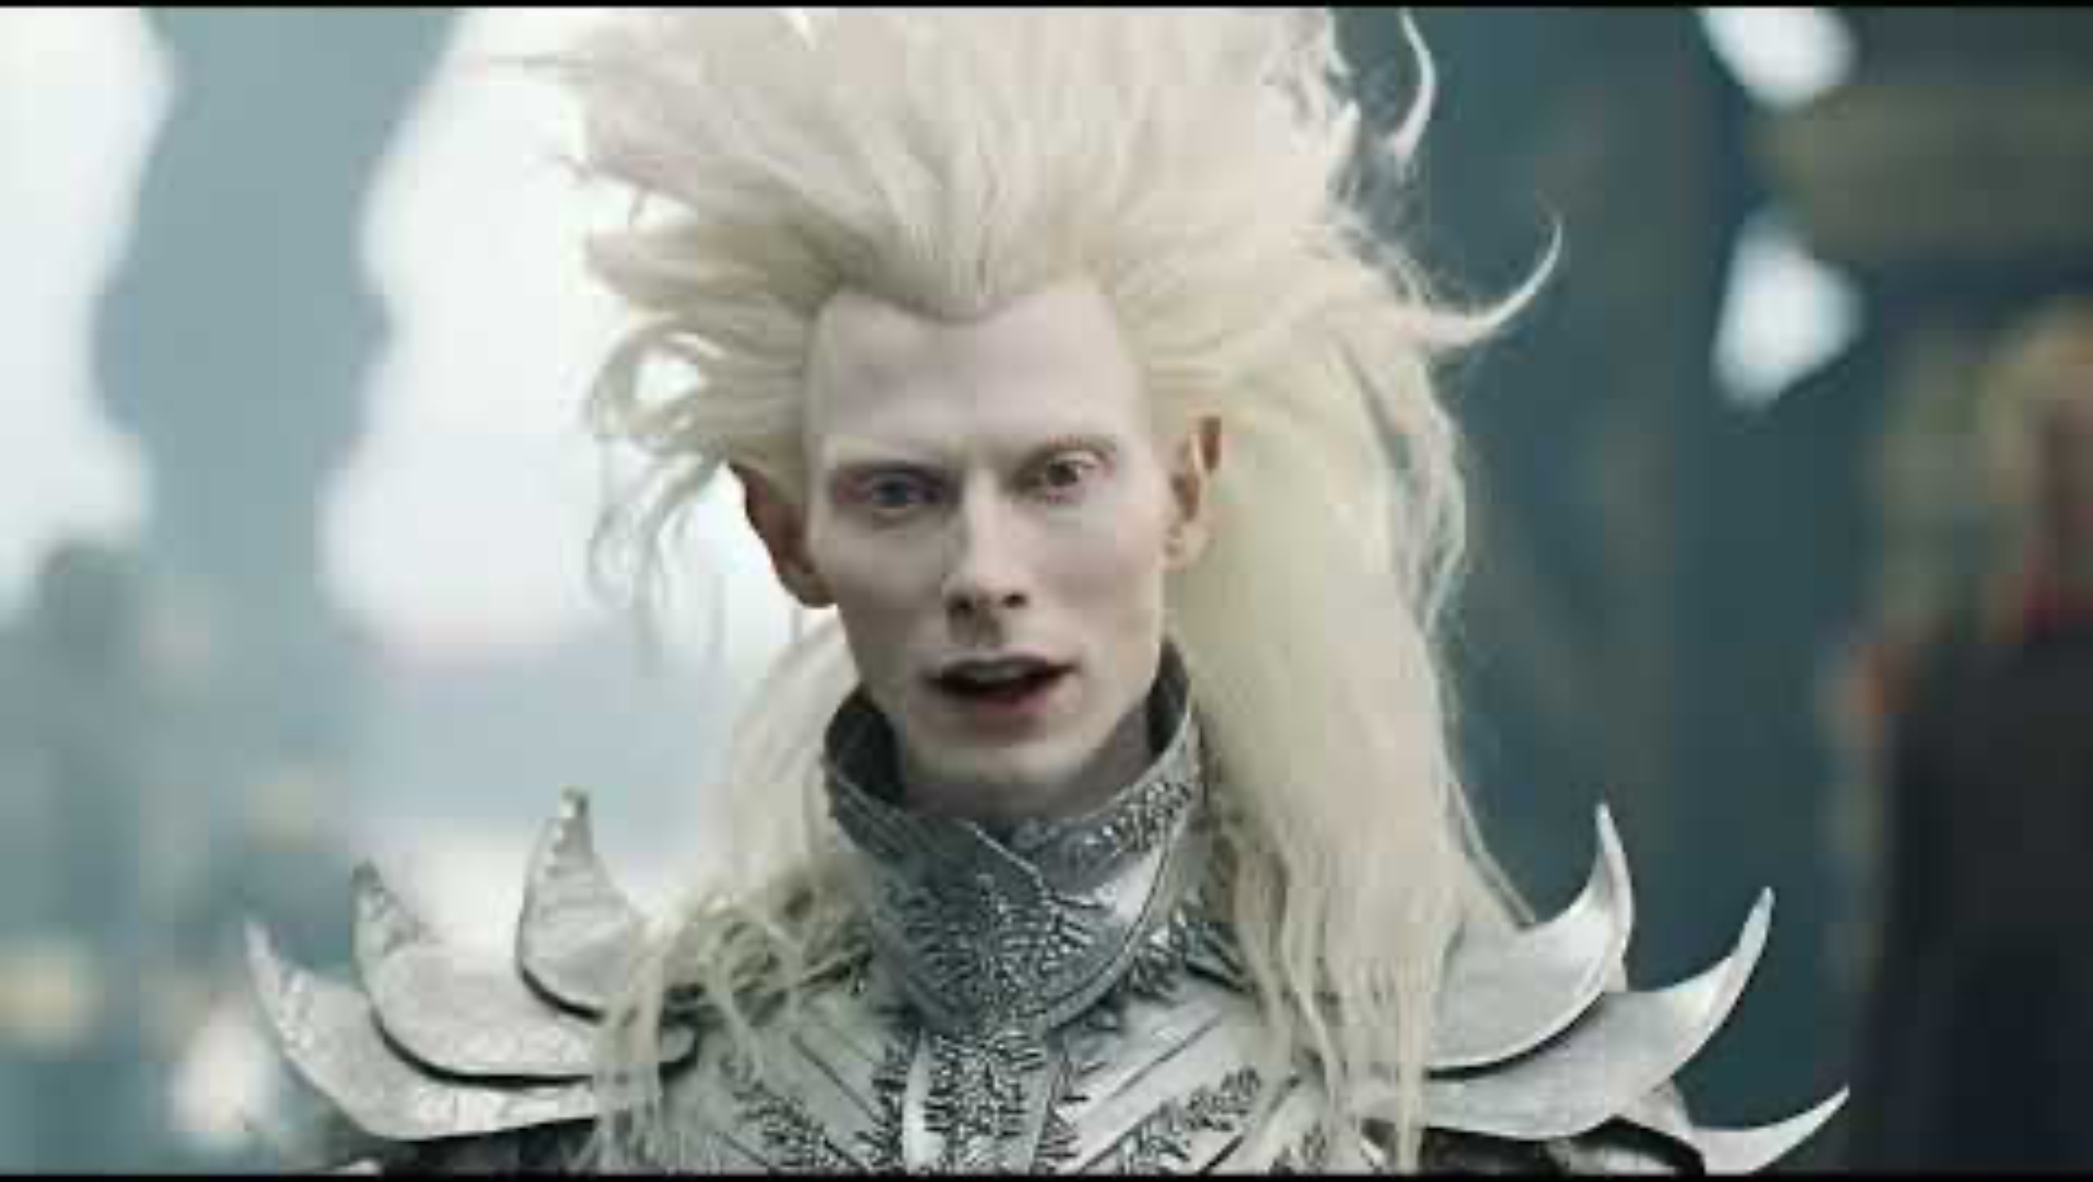

Slide 70
Grading
~6 homework assignments = total of 55% of final grade
Can be completed in groups ≤ 4
Make sure to submit it as a group to Gradescope, and don’t leave anyone off!
Larger groups will do additional work
One final project = 30%
Can be completed in groups ≤ 5
Participation + Paper presentations = 15%

Slide 71
Group Paper Presentations
Prepare multiple 10-15 minute group presentations on papers from the reading list.
Your presentation should summarize the work and discuss the ways it’s applicable to either interactive fiction or automated story generation.
We’ll follow a role-playing paper-reading seminar format where each person in your group will play a different role (e.g. Scientific Peer Reviewer, Archaeologist, Academic Researcher, Industry Practitioner, Hacker, etc)
Grading:
50%: Send us your slides by Monday at 3 PM the week of your presentation
50%: presentation to the class

Slide 72
Links
Ed Discussion (https://edstem.org/us/courses/50468/) – preferred method of contact
Course website (https://interactive-fiction-class.org) – where all homework assignments will be located
Canvas (https://canvas.upenn.edu/courses/1770477) – mainly used for calendar of due dates

Slide 73
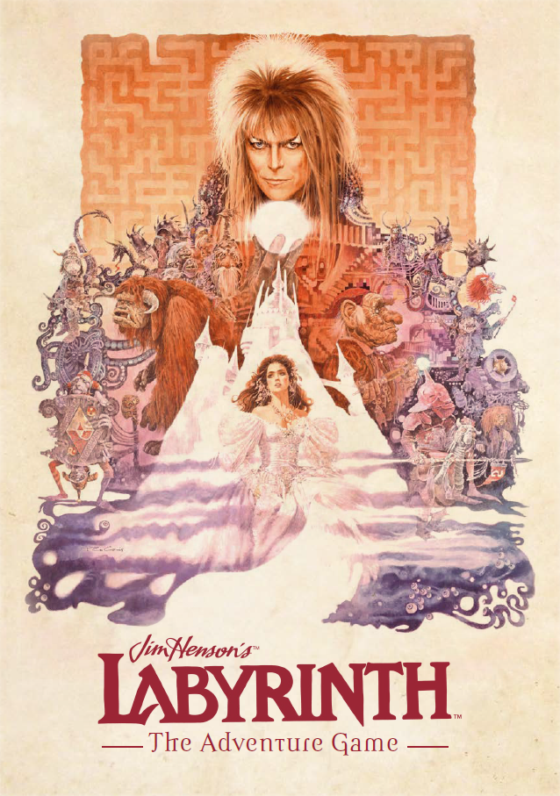
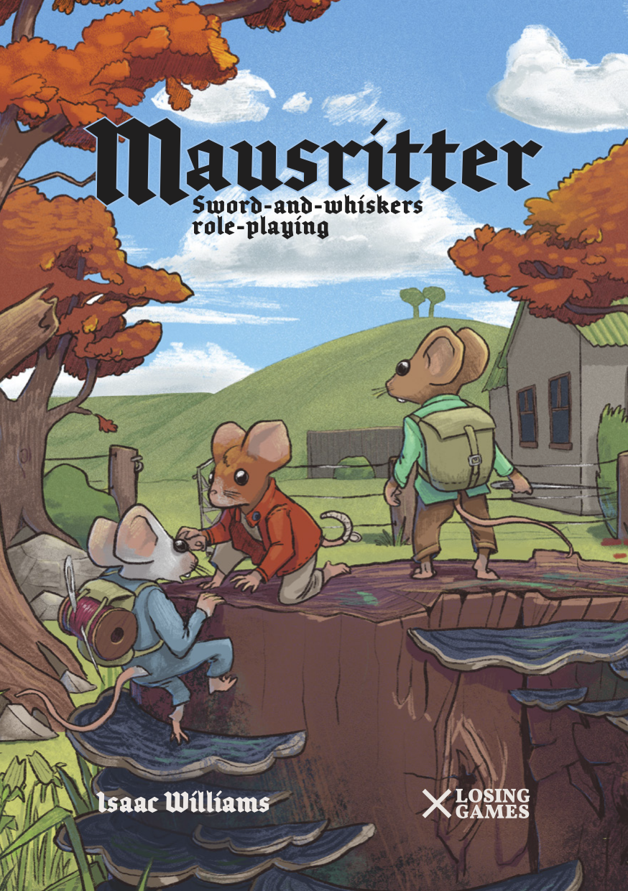
Due Tuesday January 23 before class starts

Slide 74
Homework 1
Homework 2
Implement a text adventure game in Python.
Due 1/30/24 before class starts
Learn how to work with large language models for interactive fiction.
Due 2/6/24

Slide 75
